Slide 1

A Hierarchical Machine Learning Approach for an Integrated Supply Chain with Collaborative Inventory Management
Filotas Theodosiou, Yves R. Sagaert
VIVES University of Applied Sciences
Notes:
Abstract: Collaboration in the supply chain between a retailer and a supplier has been extensively researched. Much of the relevant literature has focused on the theoretical impact of this collaboration, with several studies arguing for its potential benefits, ranging from counteracting the bullwhip effect to reducing the likelihood of a stock-out. Despite this, most empirical work has focused on improving the accuracy of supplier-level forecasting. Using regression-based approaches, retailer sales information is included as exogenous variables to improve the supplier demand forecasts. However, this has limited benefits for the retailer. In this work, we aim to reduce total supply chain costs, both at the retailer and supplier level, by tracking decisions throughout the supply chain. These decisions are usually made on different frequencies. Our case study consists of a supply chain with three echelons: shop level, distribution centre (DC) and supplier level. The decisions about replenishing inventory are made at different times for each tier, causing the decision makers to model demand at different frequencies. Driven by the advances in the hierarchical forecasting literature, we propose ordering the demand time series into temporal and cross-sectional aggregations and structure them into a partial cross-temporal hierarchy. The decisions are not taken at the same moment across supply chain echelons but usually in a reactive manner that is prone to overstocking. The hierarchical approach allows to represent the propagation of decision-making, enhancing the potential for collaboration. This creates the potential for an AI-driven integrated supply chain. We examine how this hierarchical approach enables information sharing across decision levels and data frequencies and its impact on the total supply chain. We present the results based on data from a logistics network with 275 stores, 4 distribution centres and one supplier.

Slide 2

Collaboration in Retail Supply Chain
Introduction
Increasing volatility
Disruptions in the Supply Chain
Disruptions in Costumer Behavior
Inventory
Buffer against all unforeseen
Just in time => Just in Case
What about Food & perishable goods?

Slide 3
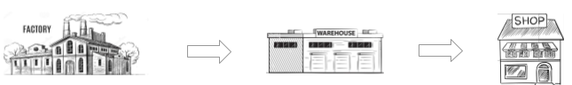

Collaboration in Retail Supply Chain
Literature Status and Challenges
Different Echelons have different collaboration goals
Different volumes and time frequencies
Different business decisions and planning horizons
Improve Upstream Forecast Accuracy
Literature Main Focus:
( Trapero et all 2012 ) Include Data from Retailer in Forecasting models
(Van Belle et all 2021)
Retailer has also benefits:
Higher Service Level & Lower Buying Costs
Lower Average Stock Through Improved Forecasts
Reduced waste (Food & Perishables)
Supplier:
Long Lead Times, Short Delivery Times
Retailer:
Short replenishment times
Trapero, J. R., Kourentzes, N., & Fildes, R. (2012). Impact of information exchange on supplier forecasting performance. Omega, 40(6), 738-747.
Van Belle, J., Guns, T., & Verbeke, W. (2021). Using shared sell-through data to forecast wholesaler demand in multi-echelon supply chains. European Journal of Operational Research

Slide 4
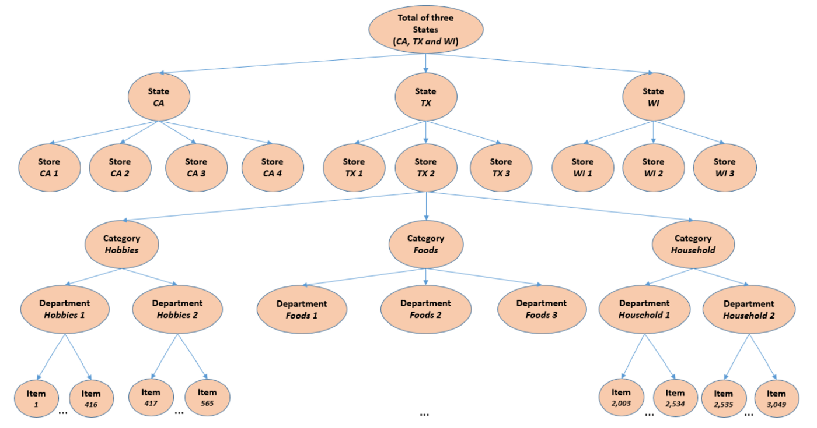
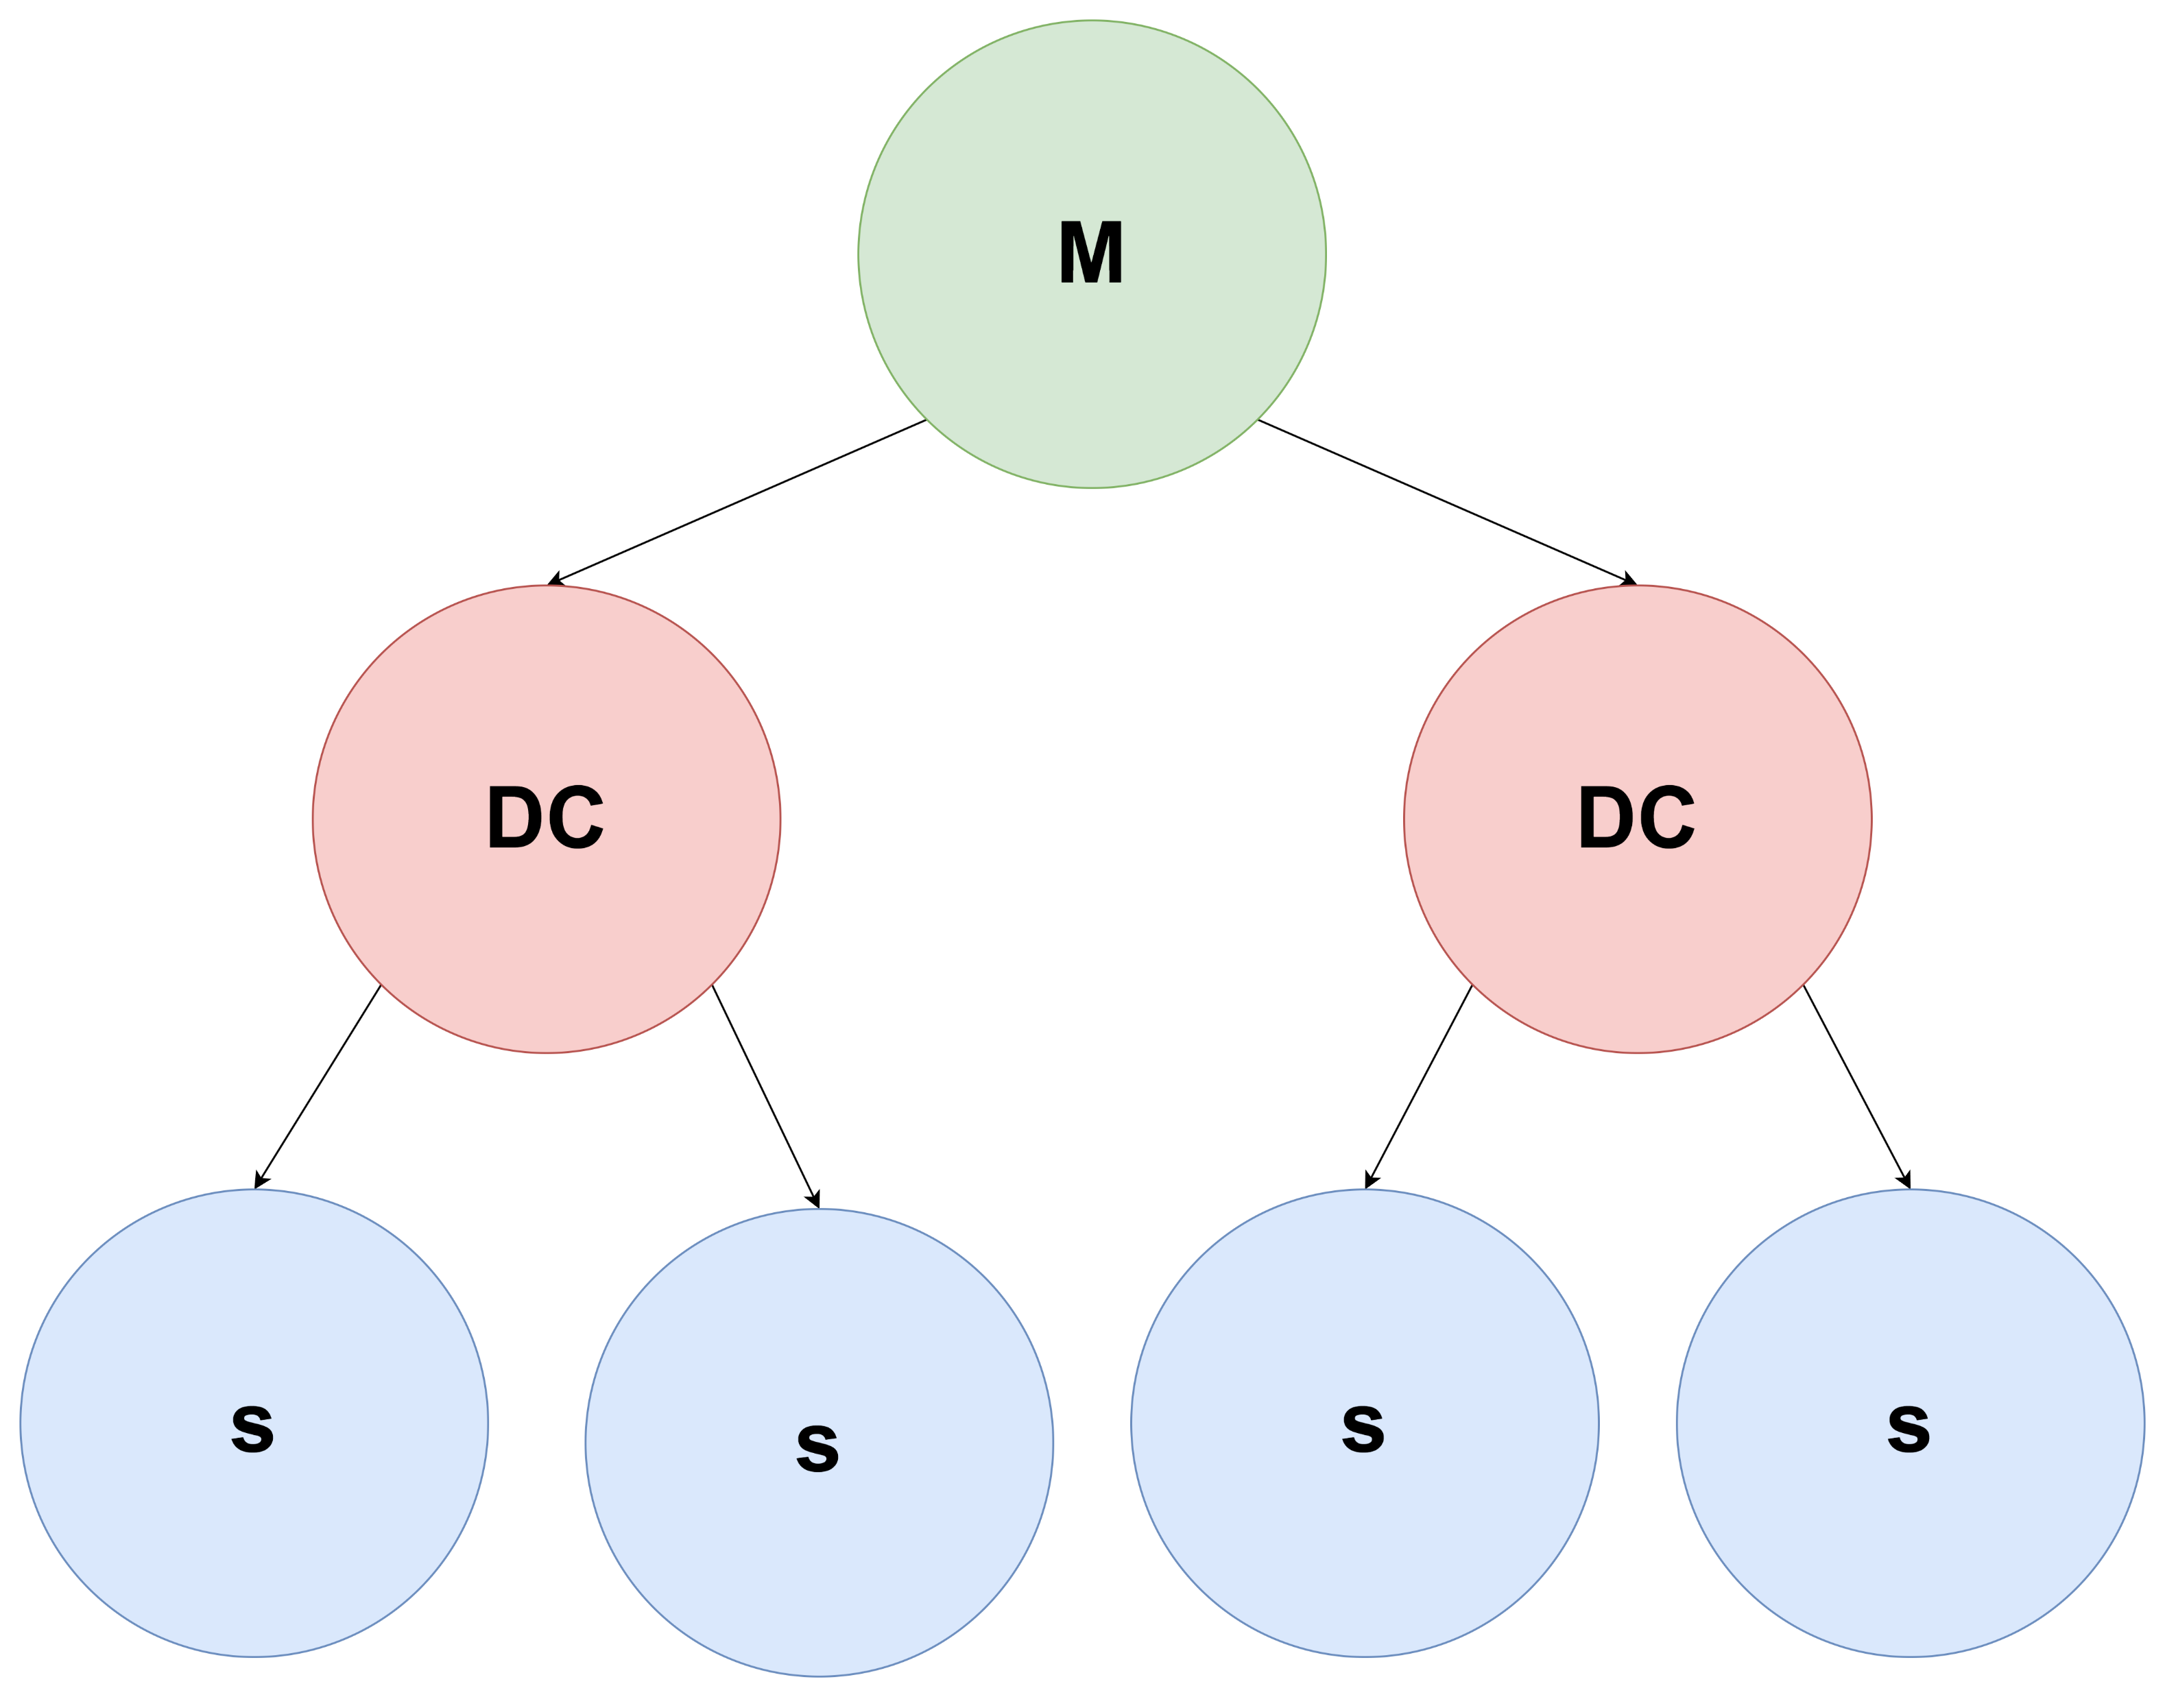
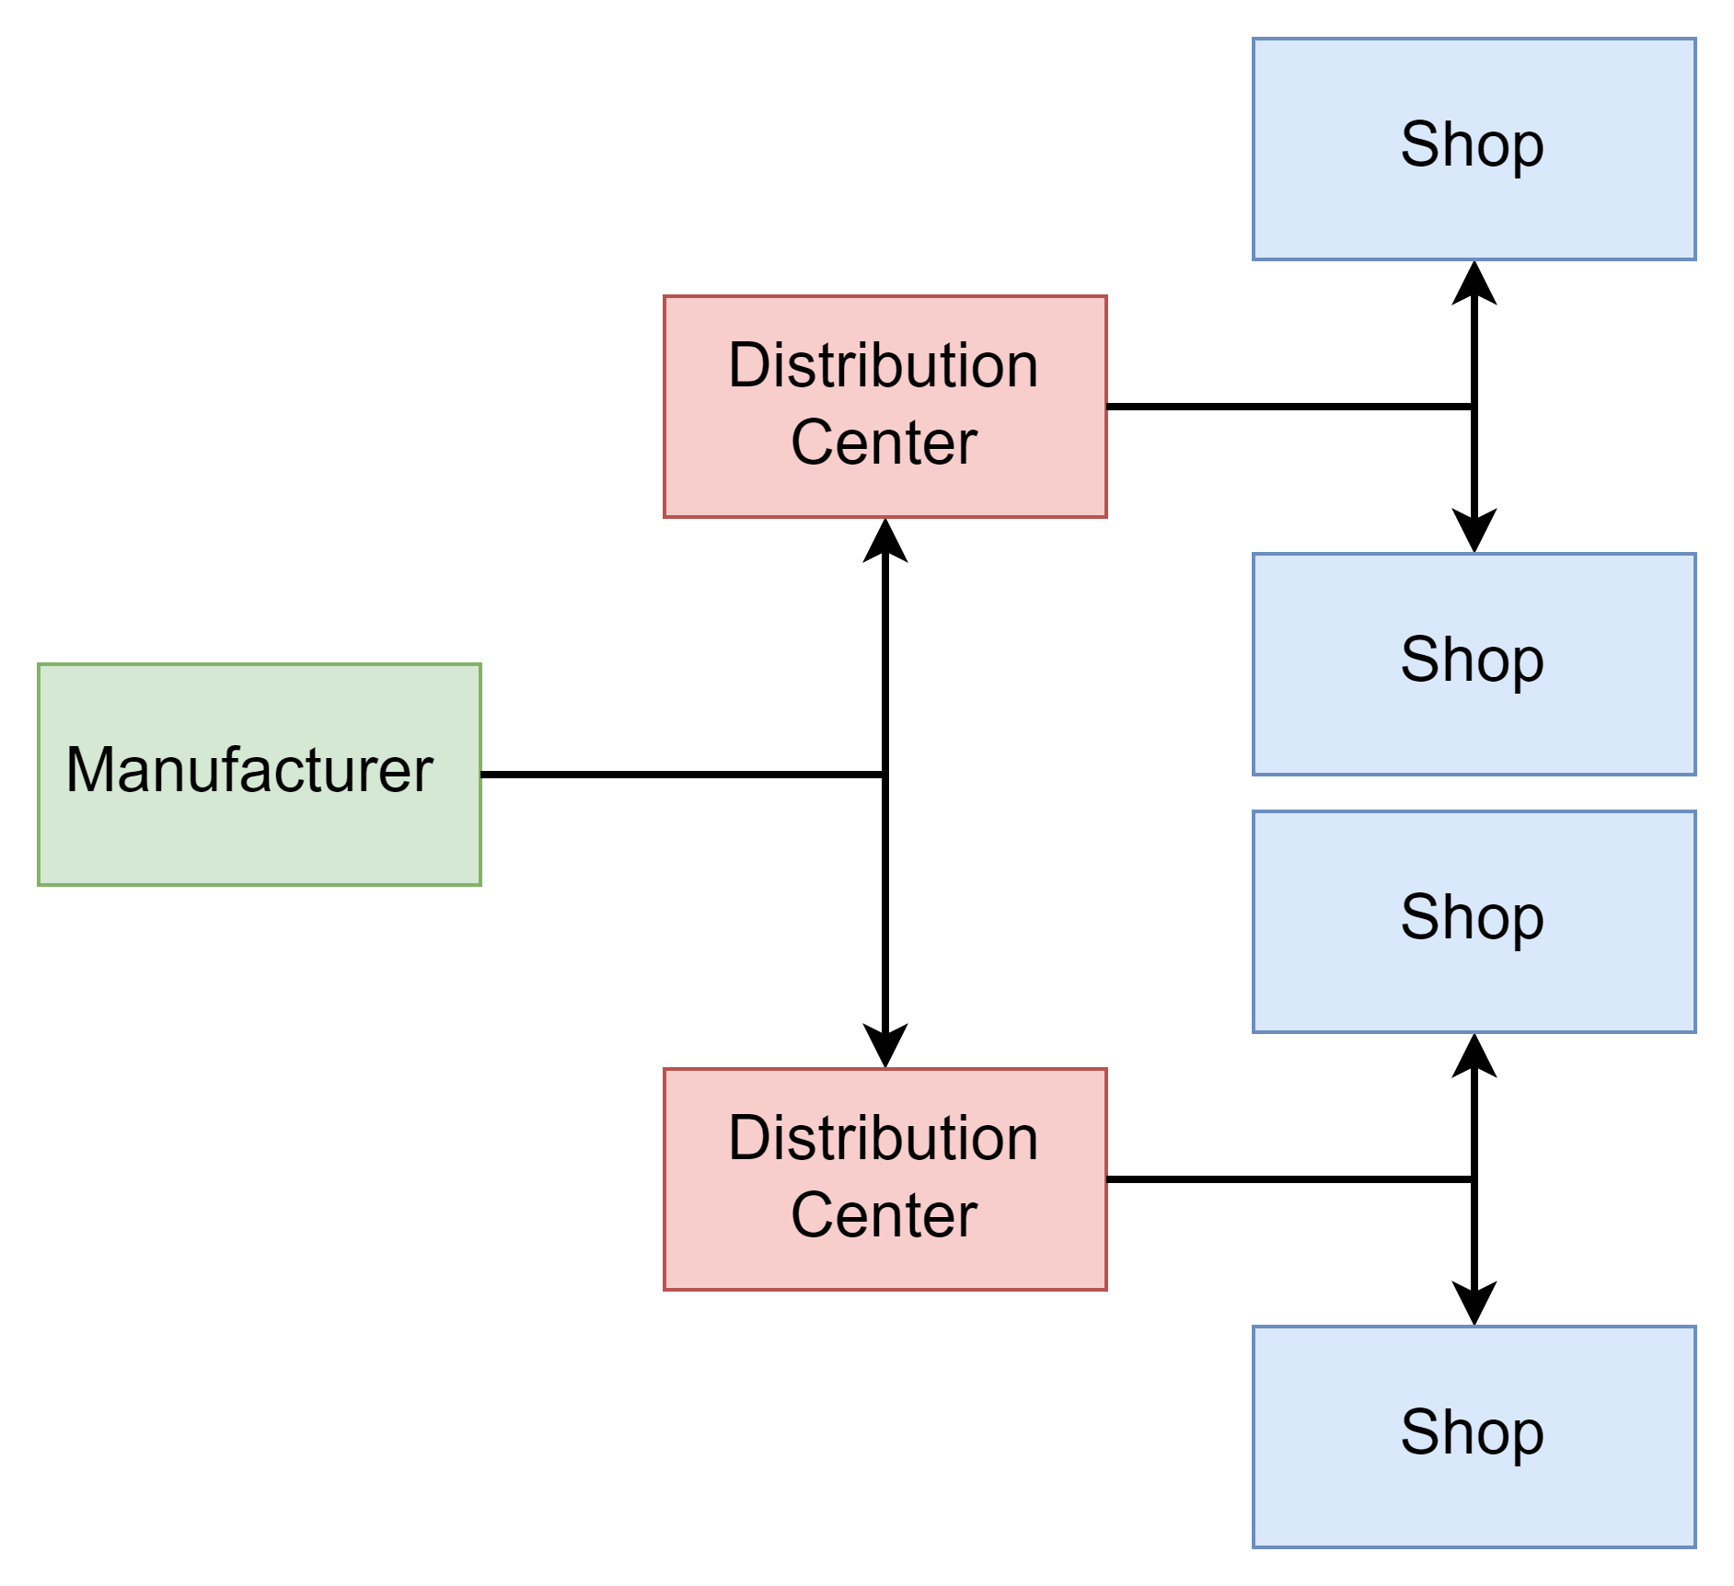
Collaboration in Retail Supply Chain
A Different View
The Inherited Hierarchical Structure on Retail (Fildes et al 2019)
SKU Level
Category
Store
…
Researchers/ Practioners took advance
Aligned Decisions Across Levels (Coherence)
Accuracy Benefits
Main Idea: Extend the Hierarchy to the Full Supply Chain
Translate echelons to hierarchical levels
Exchange of Information
Collaboration: Use of Hierarchical Forecasting methods
Common Decisions
Fildes, R, Ma, S & Kolassa, S 2019, 'Retail forecasting: Research and practice', International Journal of Forecasting. https://doi.org/10.1016/j.ijforecast.2019.06.004
Makridakis, Spyros & Spiliotis, Evangelos & Assimakopoulos, Vassilis. (2020). The M5 Accuracy competition: Results, findings and conclusions.

Slide 5

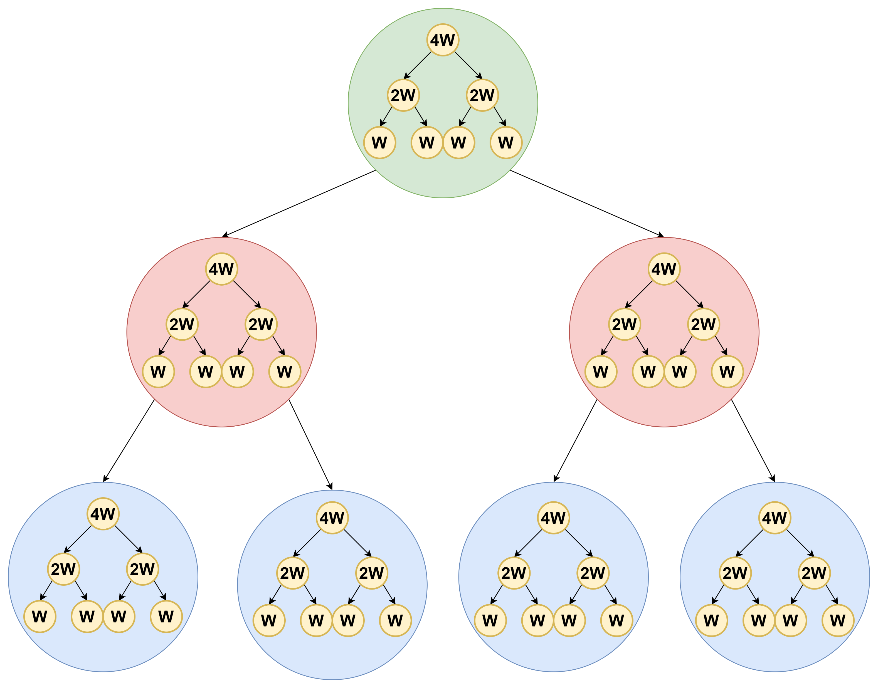
Another View of Supply Chains
Hierarchical Forecasting In a Nutshell
Intuition Behind HF Methods
Step 1: Base Forecast
Step 2: Reconcile
Rich Literature!!
A simple supply chain mapped into a hierarchy
1 Manufacturer
2 DCs
4 Shops
Strategic
What about the time dimension? Tactical
Introducing Temporal Hierarchies Operational
Can we combine the two worlds?
Cross – Temporal Hierarchies: A temporal Hierarchy inside each cross section
Key Questions!
Efficiency! Do we need all levels?
How to Reconcile? Reference nikos and the Italians
How do we map this into a supply chain??
Kourentzes, N., & Athanasopoulos, G. (2019). Cross-temporal coherent forecasts for Australian tourism. Annals of Tourism Research, 75, 393-409.
Athanasopoulos, George & Hyndman, Rob & Kourentzes, Nikolaos & Petropoulos, Fotios. (2017). Forecasting with Temporal Hierarchies. European Journal of Operational Research.
Shanika L. Wickramasuriya, George Athanasopoulos & Rob J. Hyndman (2019) Optimal Forecast Reconciliation for Hierarchical and Grouped Time Series Through Trace Minimization, Journal of the American Statistical Association

Slide 6
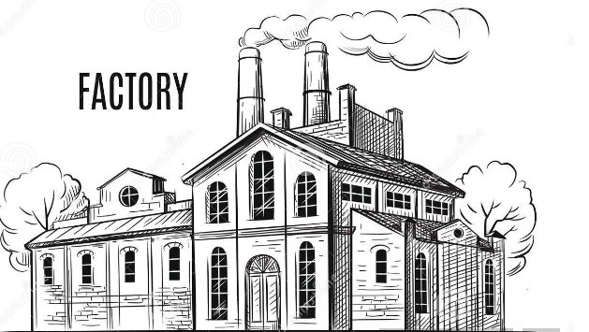
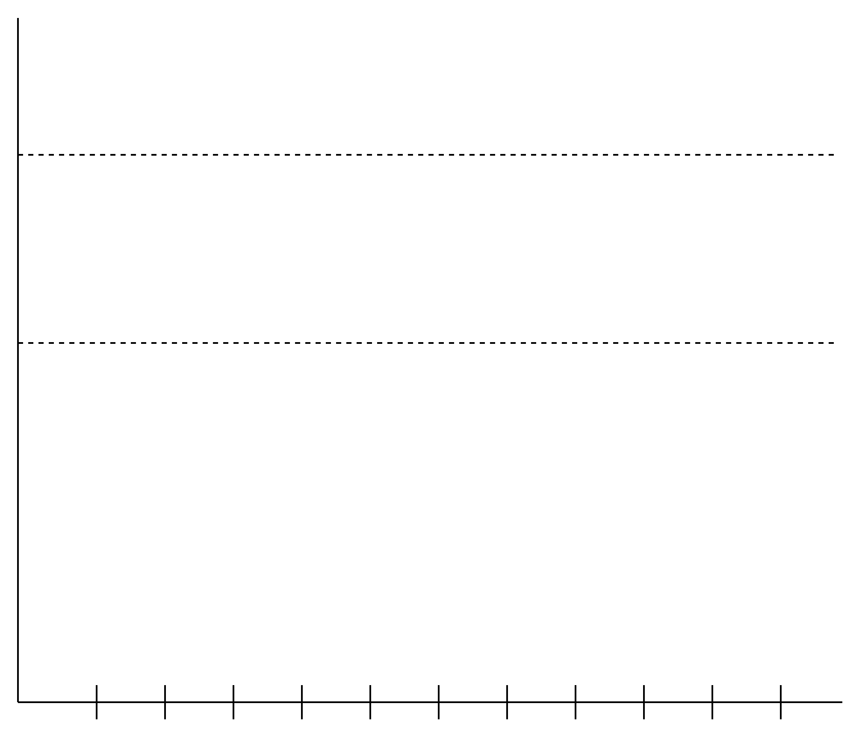
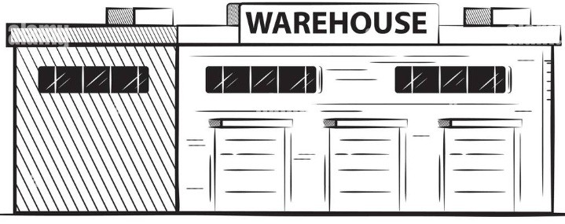
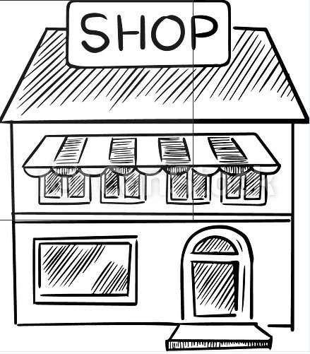
Another View of Supply Chains
Mapping a Supply Chain to a Hierarchy

Slide 7
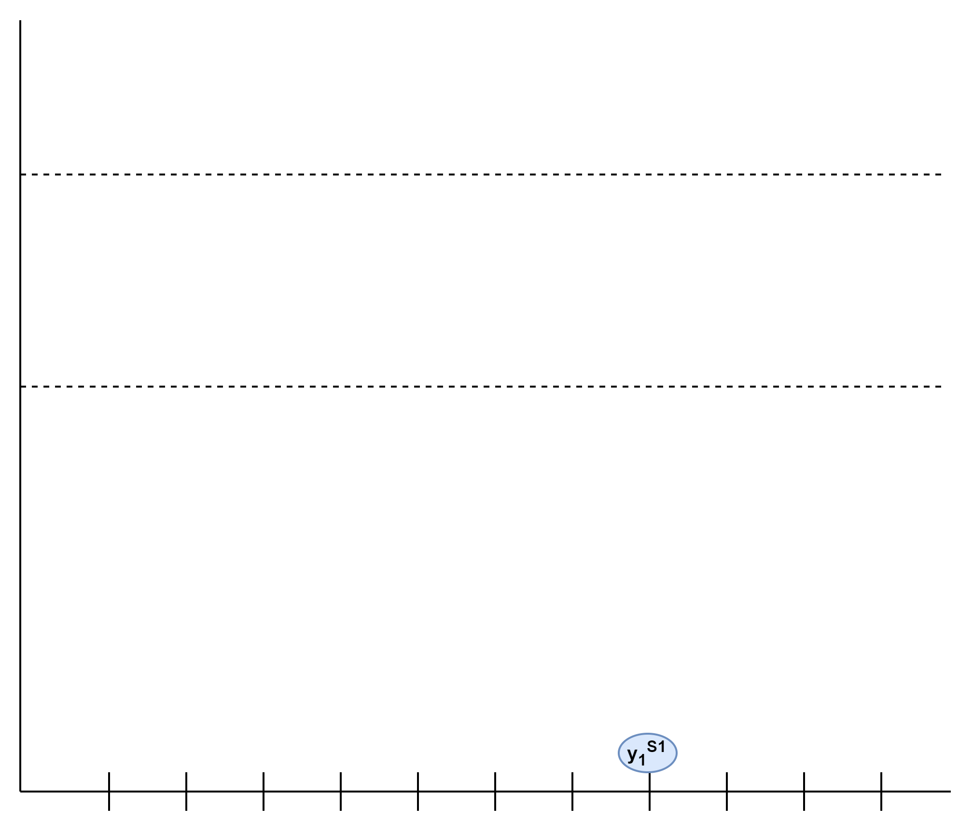
Another View of Supply Chains
Mapping a Supply Chain to a Hierarchy

Slide 8
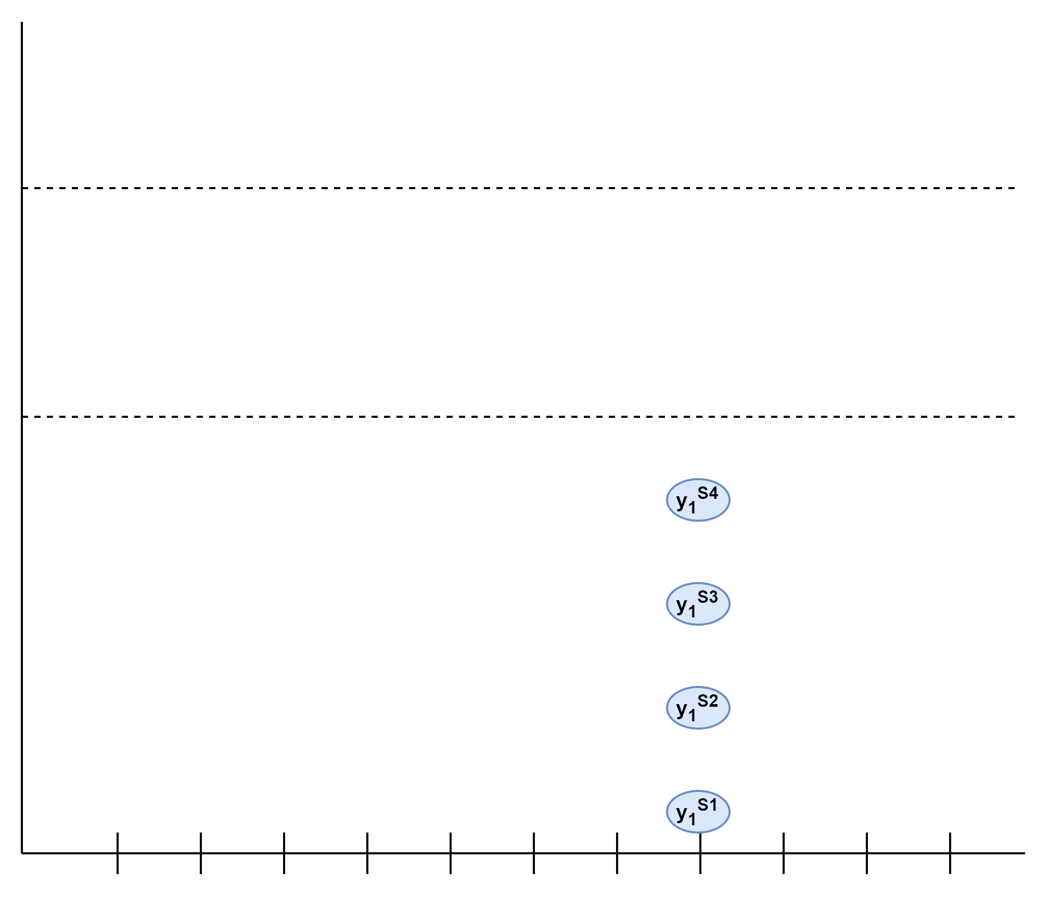
Another View of Supply Chains
Mapping a Supply Chain to a Hierarchy

Slide 9
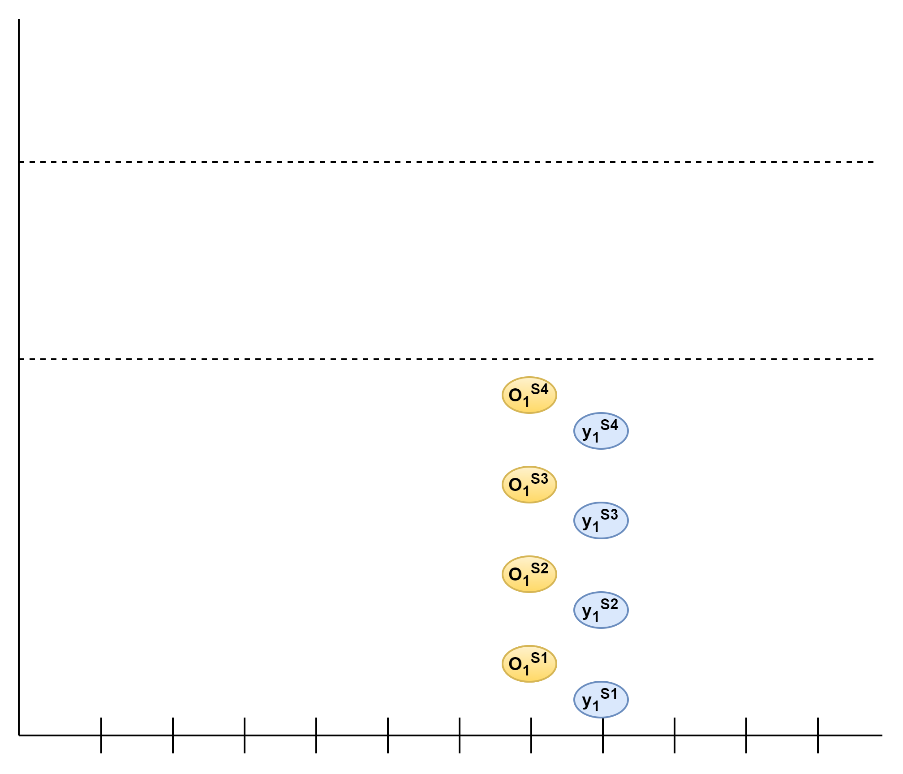
Another View of Supply Chains
Mapping a Supply Chain to a Hierarchy

Slide 10


Another View of Supply Chains
Mapping a Supply Chain to a Hierarchy
We need to consider our stock-at-hand

Slide 11
Another View of Supply Chains
Mapping a Supply Chain to a Hierarchy
Challenges
Stock at Hand

Slide 12
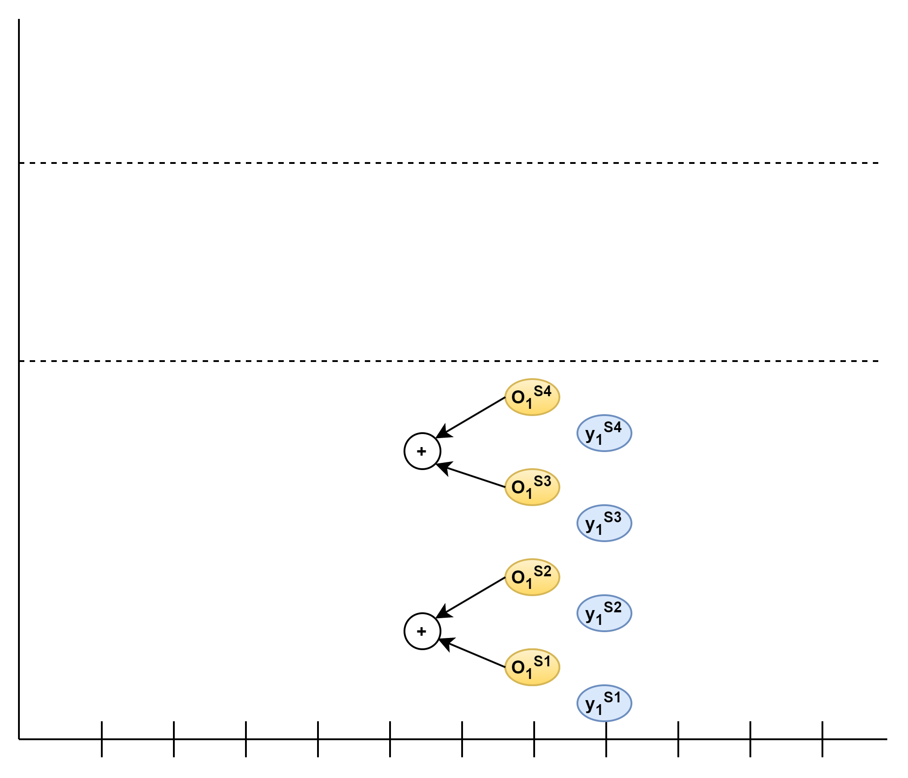
Another View of Supply Chains
Mapping a Supply Chain to a Hierarchy
Challenges
Stock at Hand

Slide 13
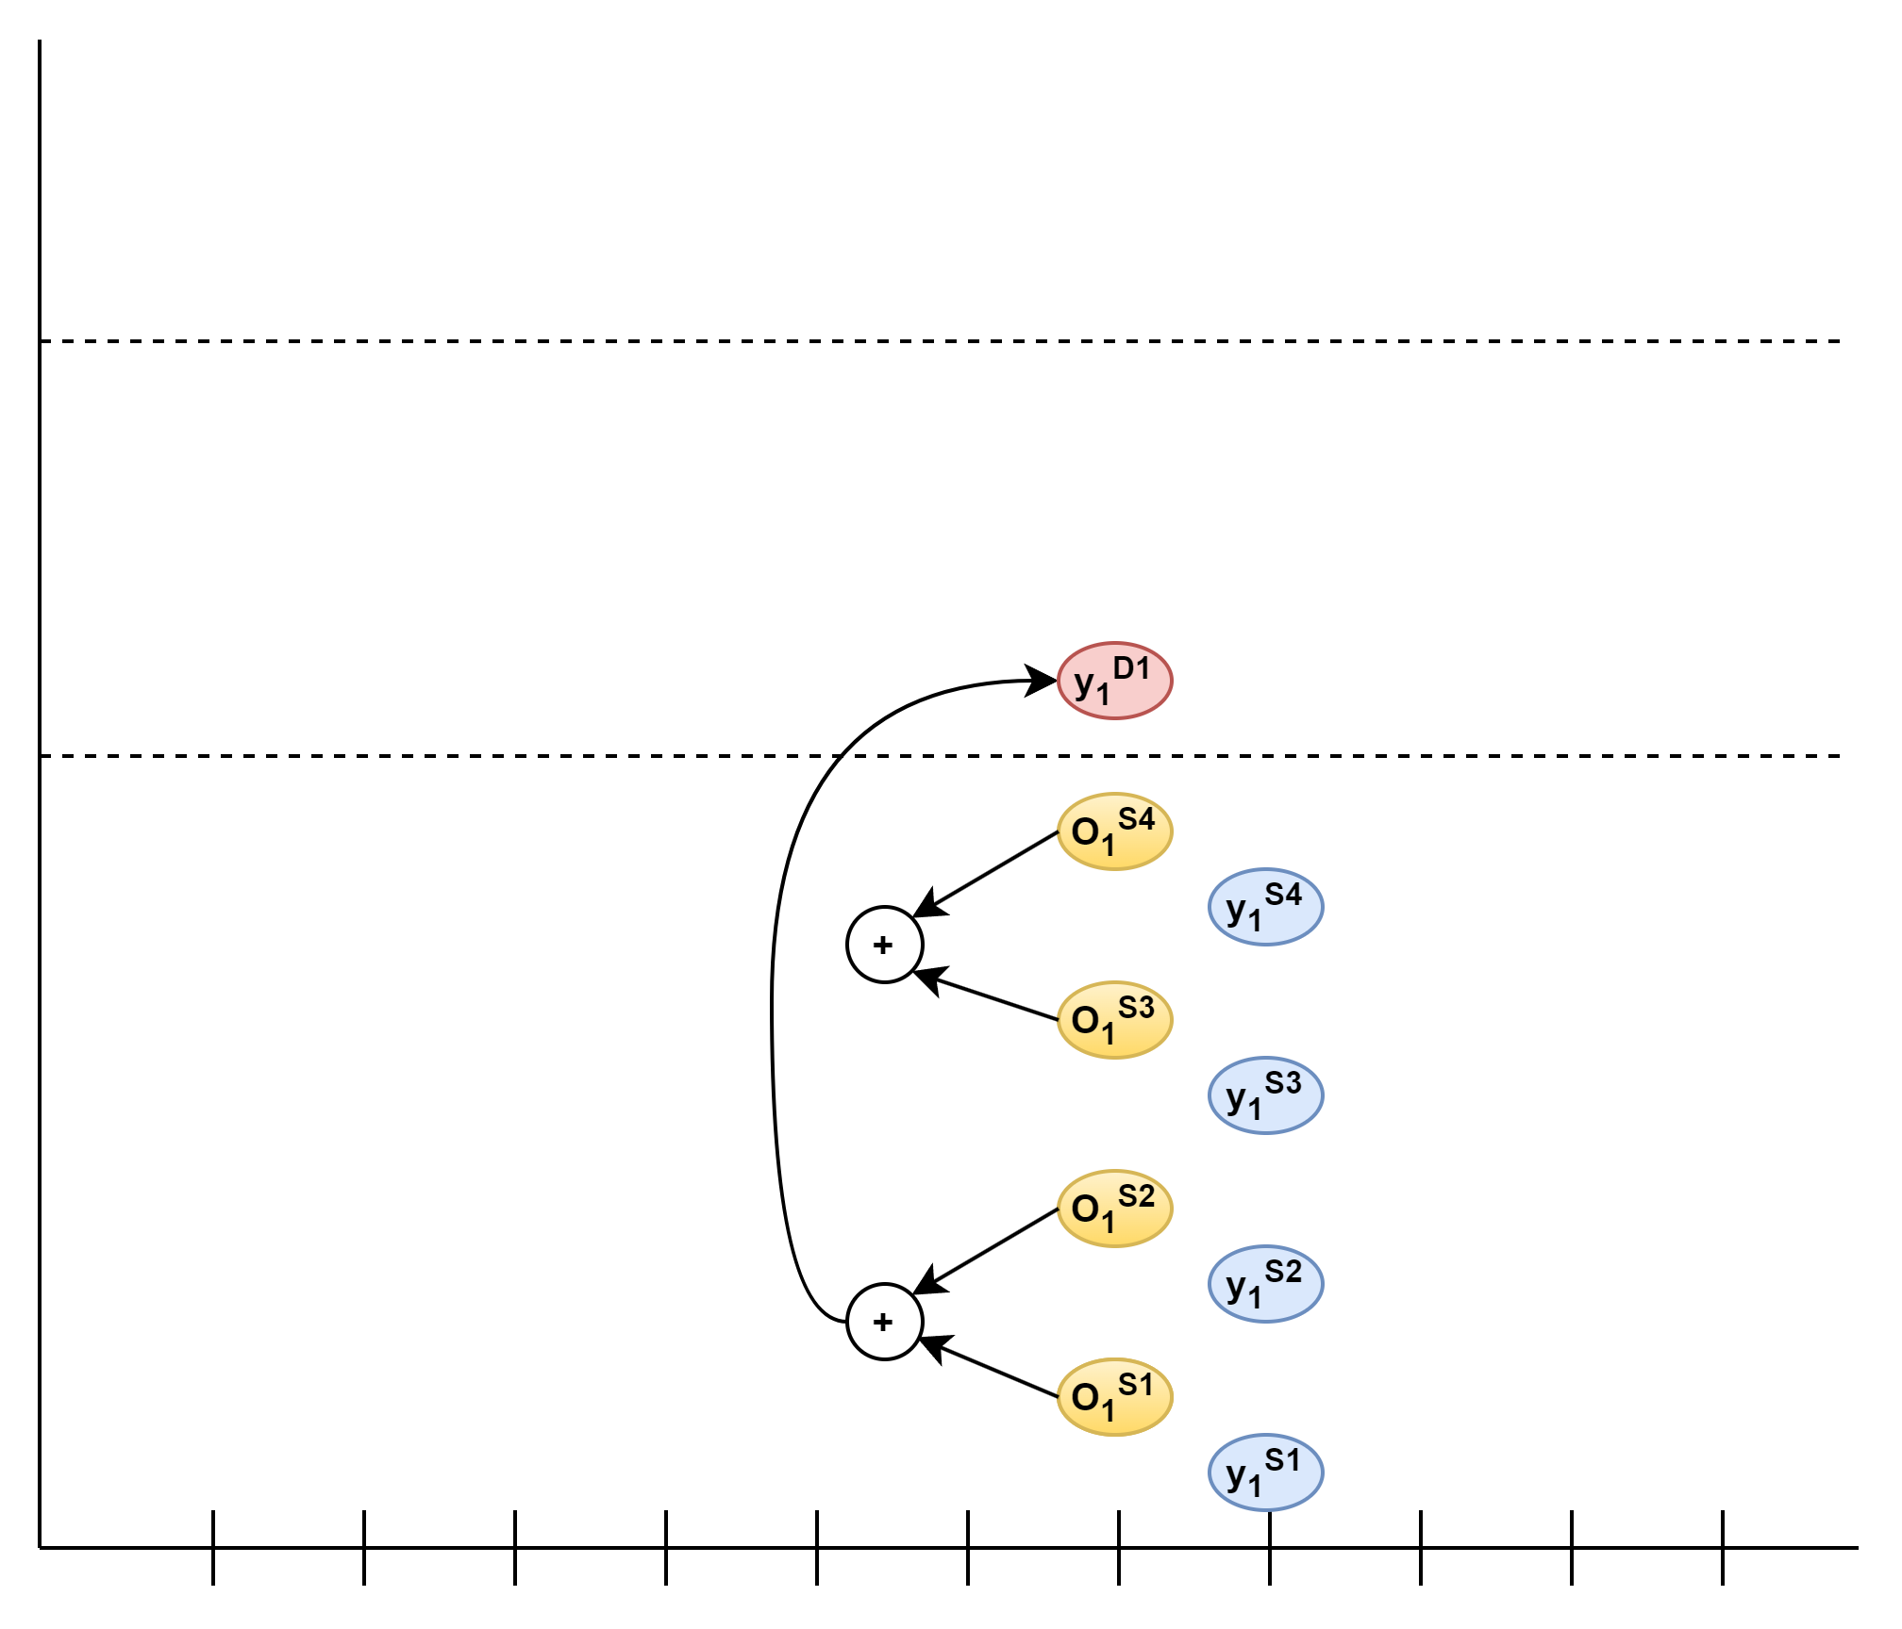
Another View of Supply Chains
Mapping a Supply Chain to a Hierarchy
Challenges
Stock at Hand

Slide 14
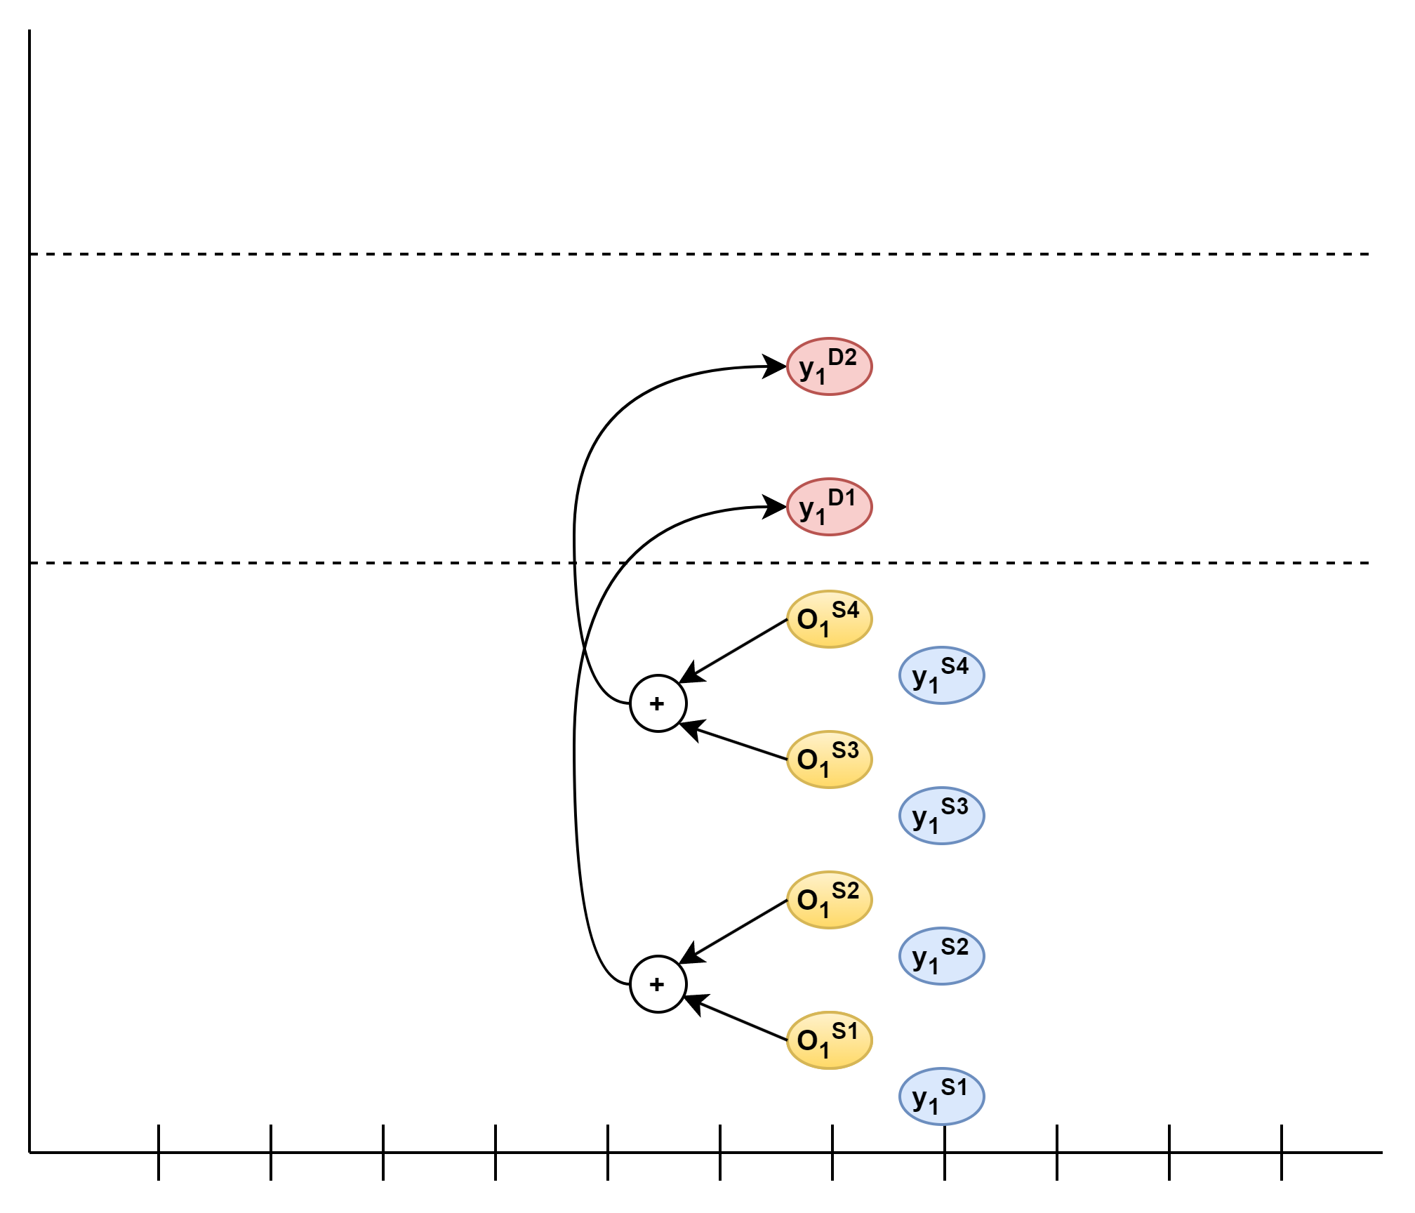
Another View of Supply Chains
Mapping a Supply Chain to a Hierarchy
Challenges
Stock at Hand

Slide 15
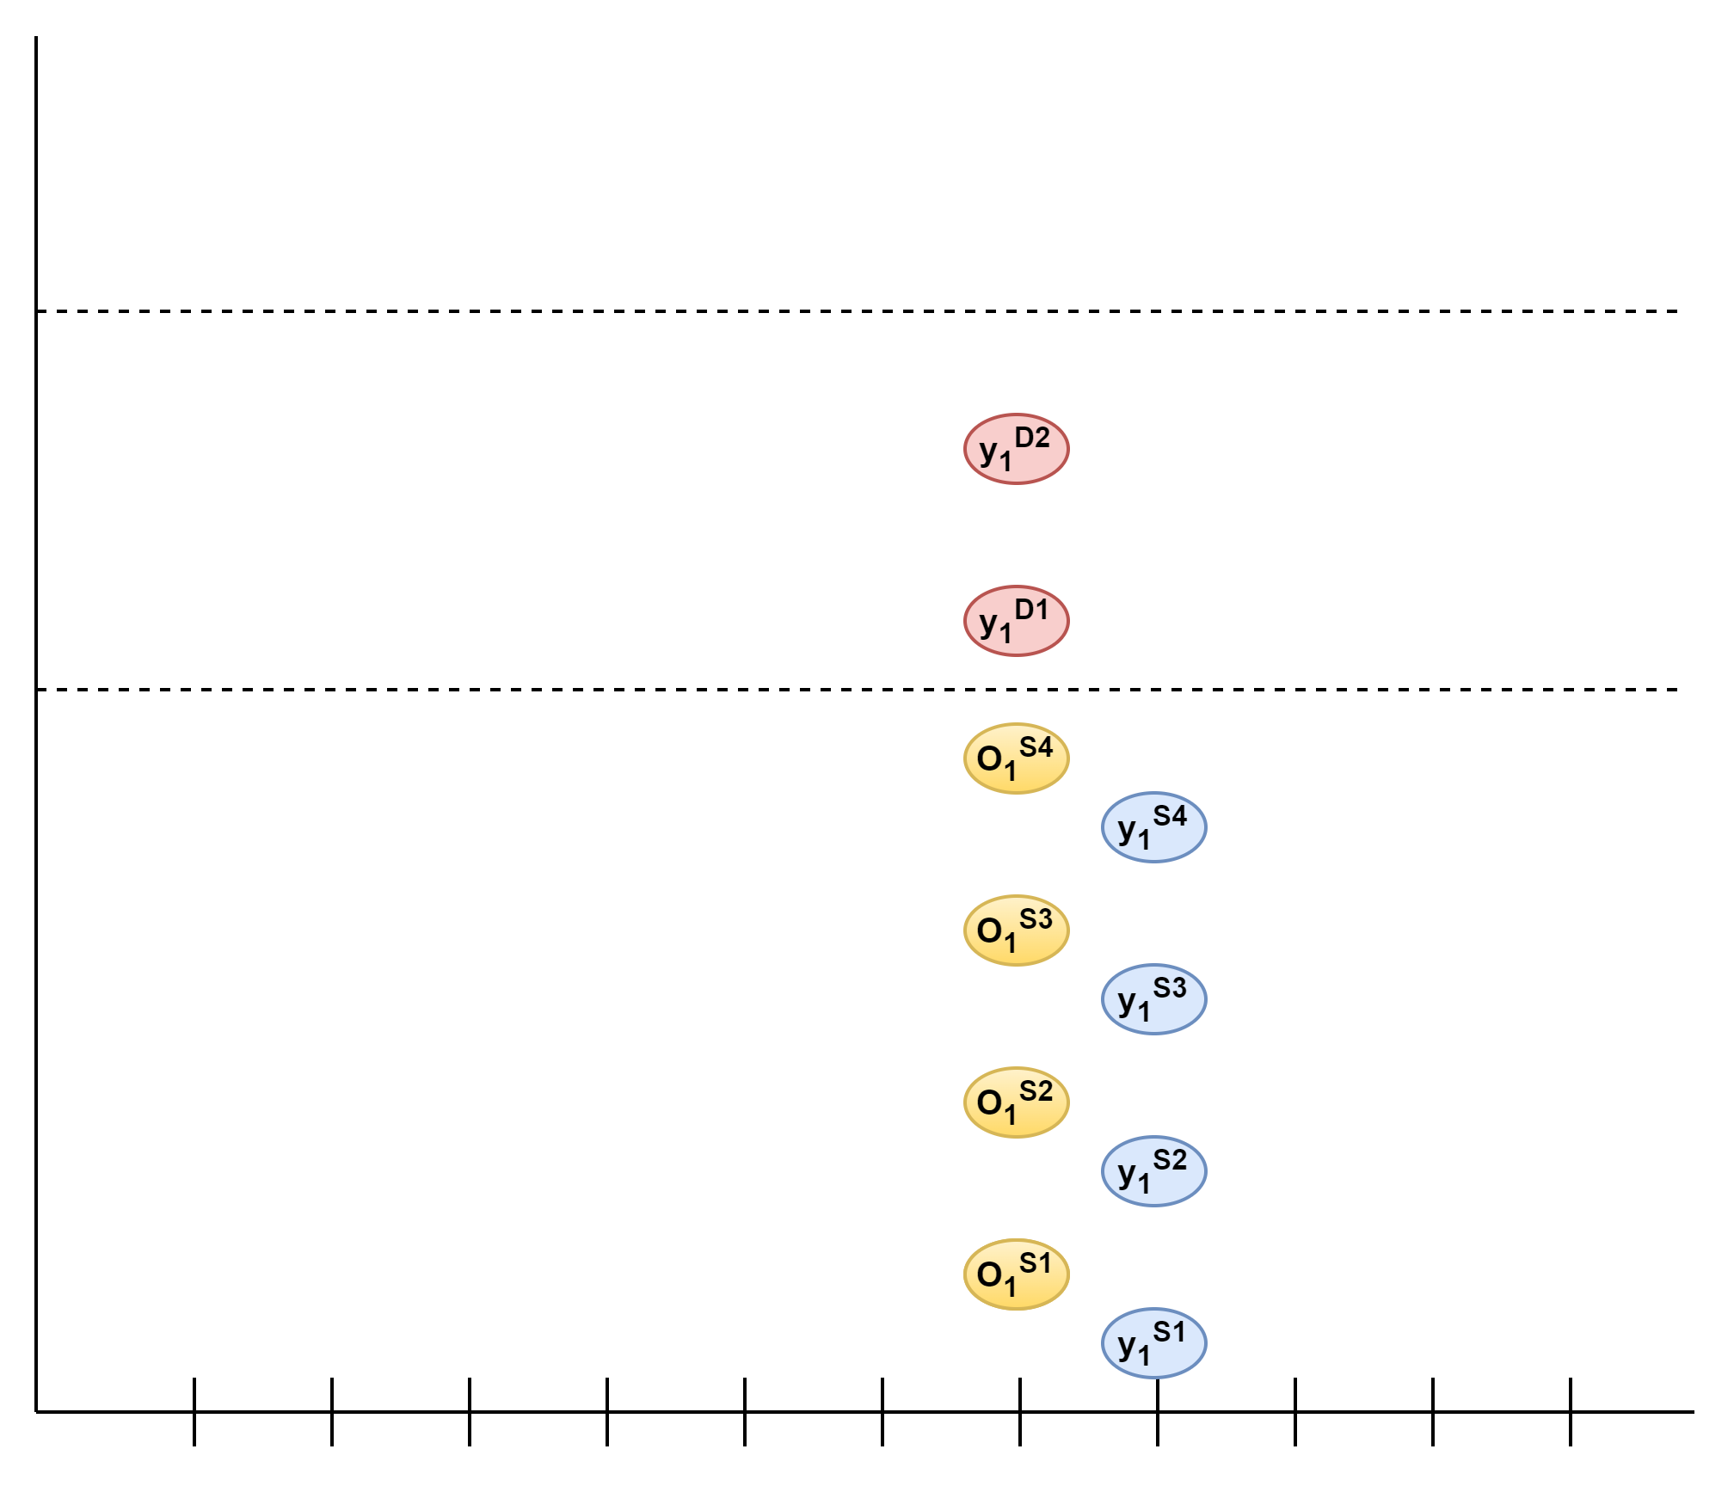
Another View of Supply Chains
Mapping a Supply Chain to a Hierarchy
Challenges
Stock at Hand
Recurrent Nature of Demand

Slide 16
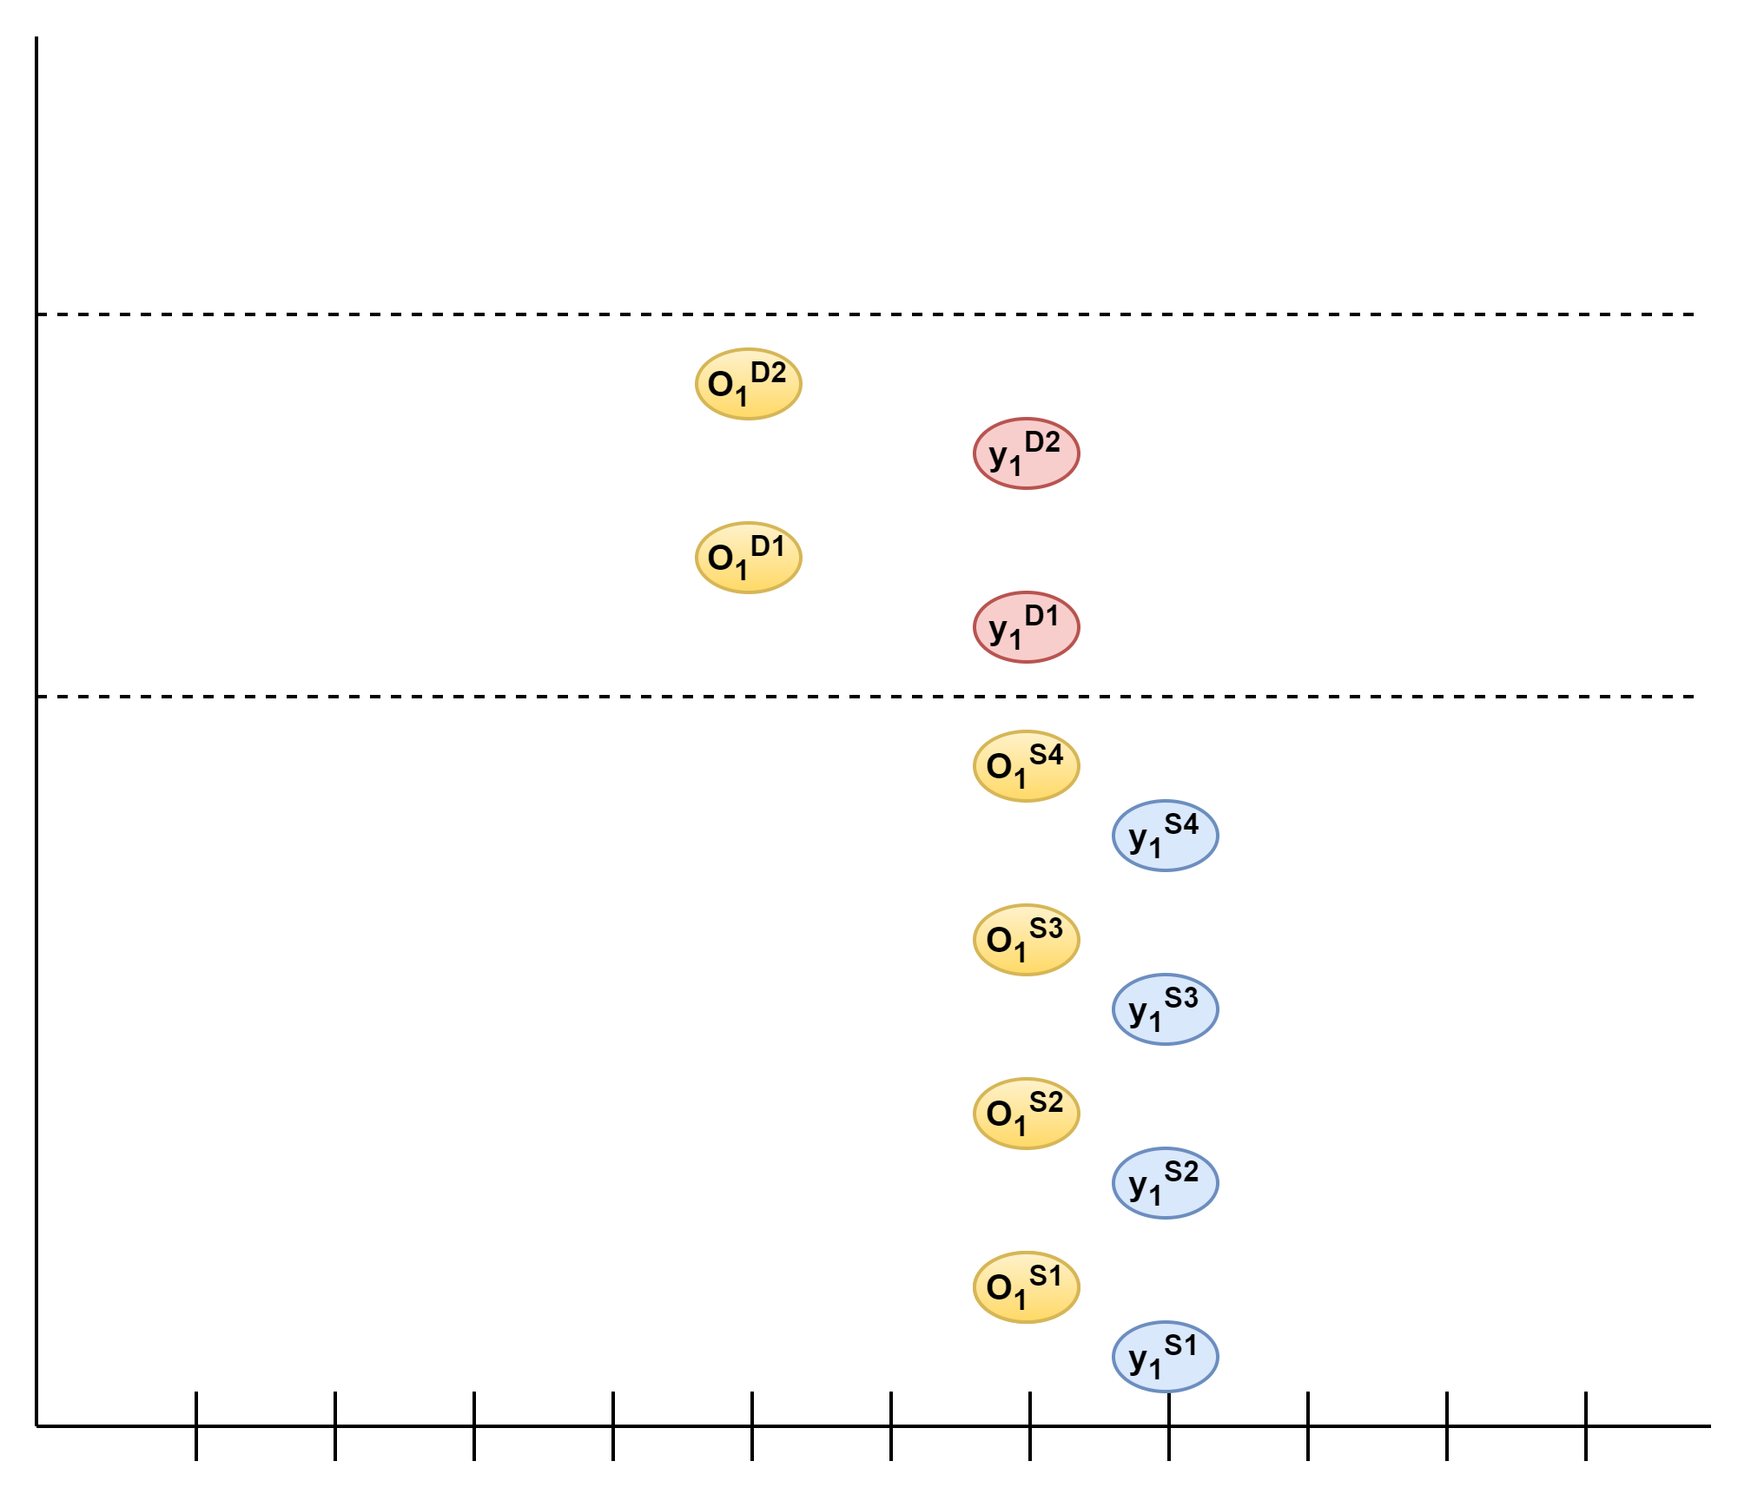
Another View of Supply Chains
Mapping a Supply Chain to a Hierarchy
Challenges
Stock at Hand
Recurrent Nature of Demand
Different Ordering Frequencies

Slide 17
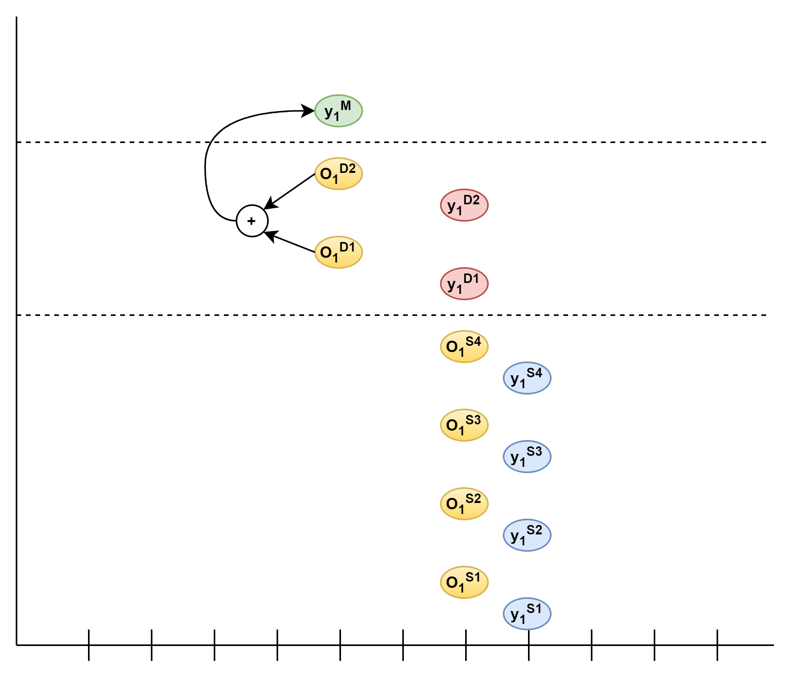
Another View of Supply Chains
Mapping a Supply Chain to a Hierarchy
Challenges
Stock at Hand
Recurrent Nature of Demand
Different Ordering Frequencies

Slide 18
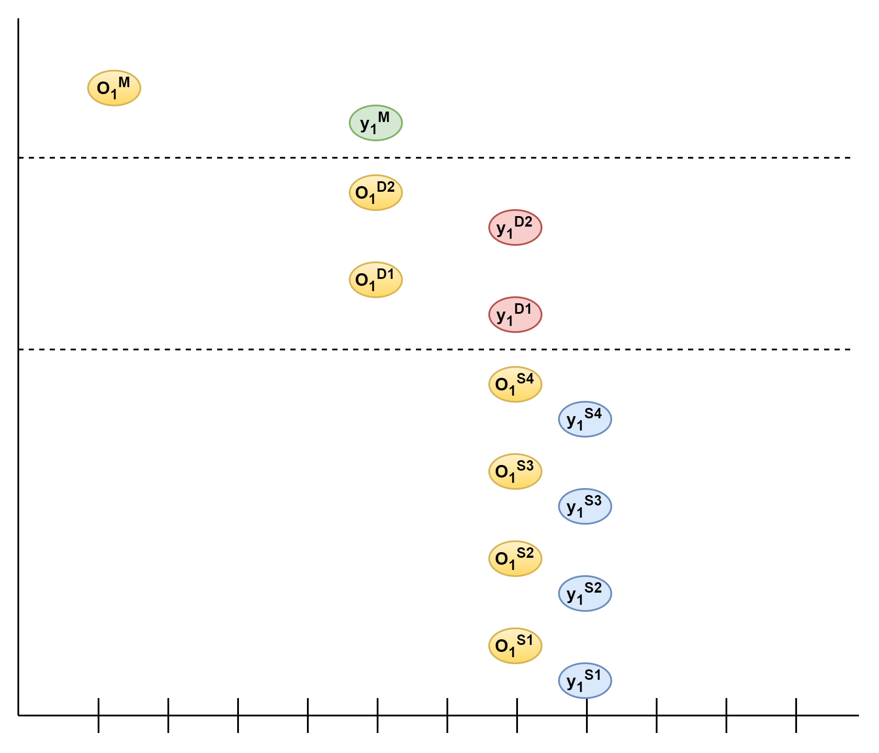
Another View of Supply Chains
Mapping a Supply Chain to a Hierarchy
Challenges
Stock at Hand
Recurrent Nature of Demand
Different Ordering Frequencies

Slide 19

Another View of Supply Chains
Mapping a Supply Chain to a Hierarchy
Challenges
Stock at Hand
Recurrent Nature of Demand
Different Ordering Frequencies
When to Forecast?

Slide 20
Another View of Supply Chains
Mapping a Supply Chain to a Hierarchy
Challenges
Stock at Hand
Recurrent Nature of Demand
Different Ordering Frequencies
When to Forecast?
Common forecasting times for different horizons

Slide 21
Another View of Supply Chains
Mapping a Supply Chain to a Hierarchy
Challenges
Stock at Hand
Recurrent Nature of Demand
Different Ordering Frequencies
When to Forecast?
Common forecasting times for different horizons
Global Forecasting Moment
t = 0

Slide 22
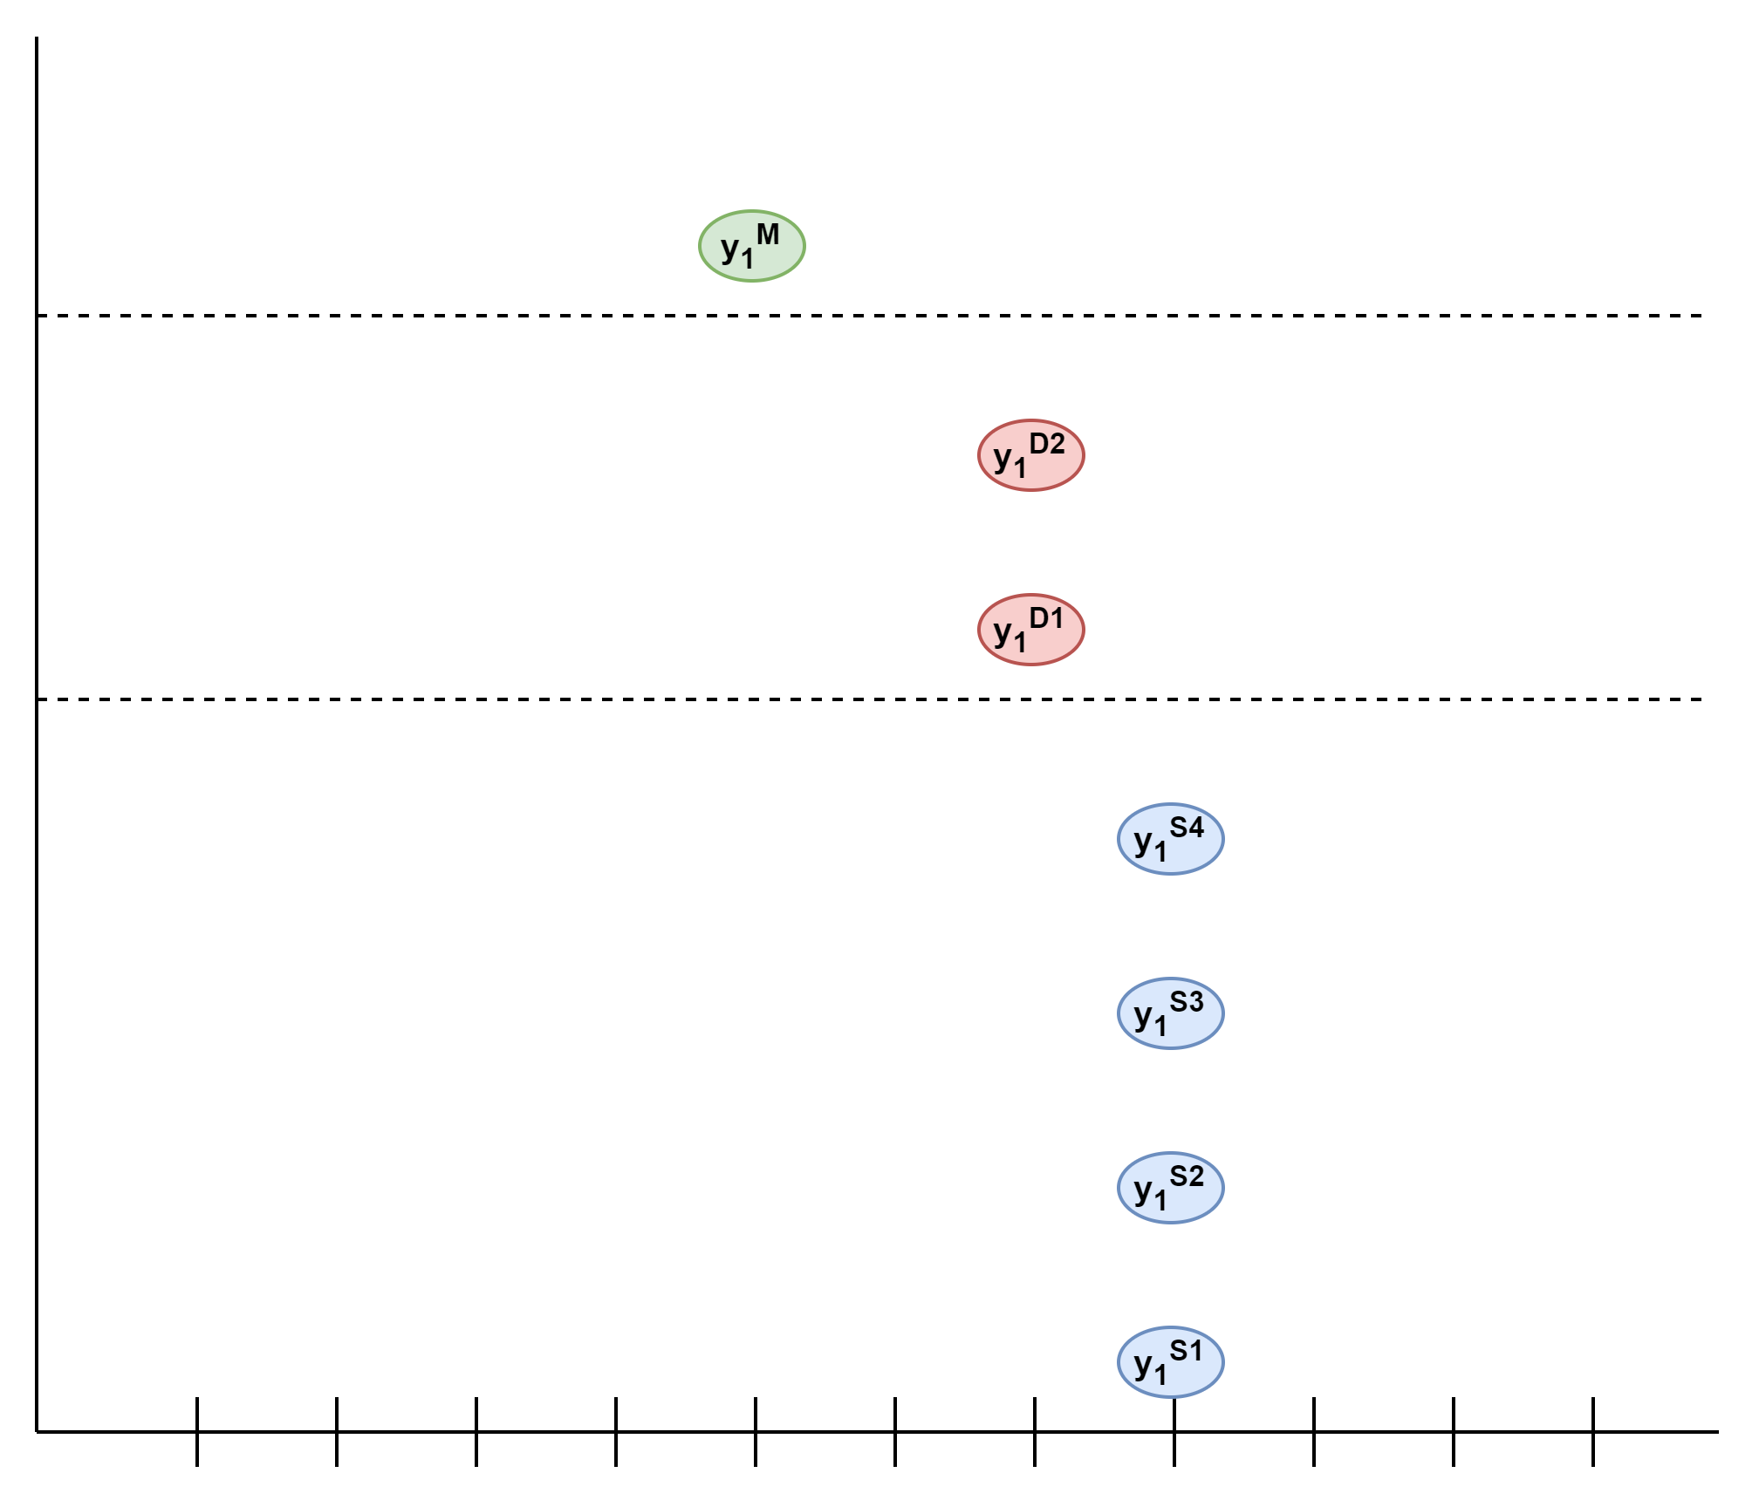
Another View of Supply Chains
Mapping a Supply Chain to a Hierarchy
Challenges
Stock at Hand
Recurrent Nature of Demand
Different Ordering Frequencies
When to Forecast?
Common forecasting times for different horizons
t = 0

Slide 23
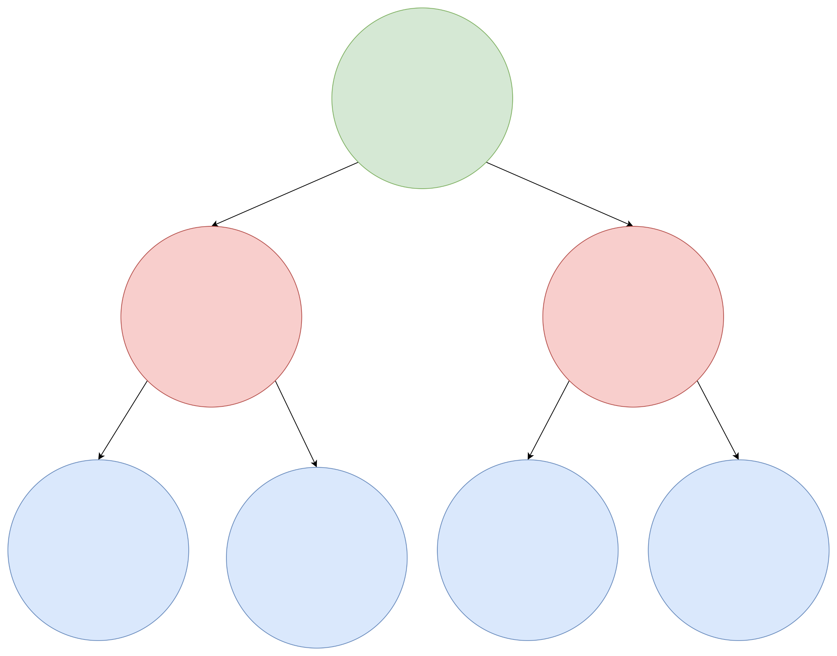
Another View of Supply Chains
Mapping a Supply Chain to a Hierarchy
Challenges
Stock at Hand
Recurrent Nature of Demand
Different Ordering Frequencies
When to Forecast?
Common forecasting times for different horizons
t = 0

Slide 24

Another View of Supply Chains
Mapping a Supply Chain to a Hierarchy
Challenges
Stock at Hand
Recurrent Nature of Demand
Different Ordering Frequencies
When to Forecast?
Common forecasting times for different horizons
t = 0

Slide 25
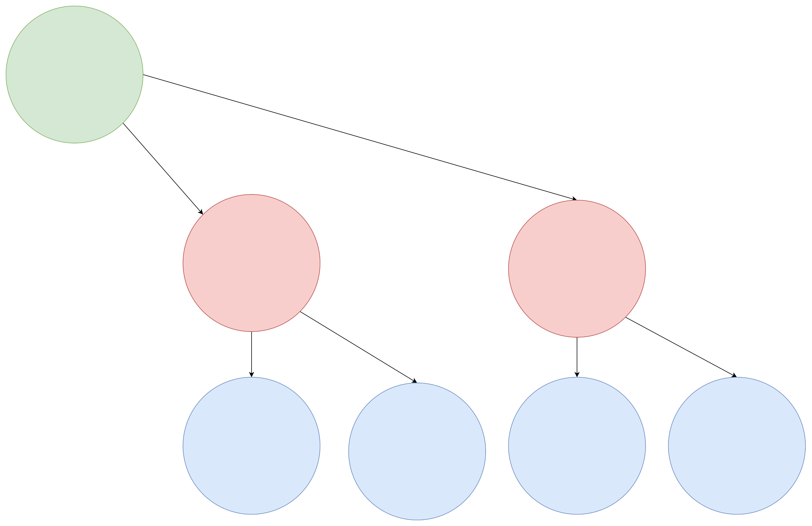
Another View of Supply Chains
Mapping a Supply Chain to a Hierarchy
Challenges
Stock at Hand
Recurrent Nature of Demand
Different Ordering Frequencies
When to Forecast?
Common forecasting times for different horizons
t = 0

Slide 26
Another View of Supply Chains
Mapping a Supply Chain to a Hierarchy
Challenges
Stock at Hand
Recurrent Nature of Demand
Different Ordering Frequencies
When to Forecast?
Common forecasting times for different horizons
“Skewed” Hierarchy
t = 0

Slide 27
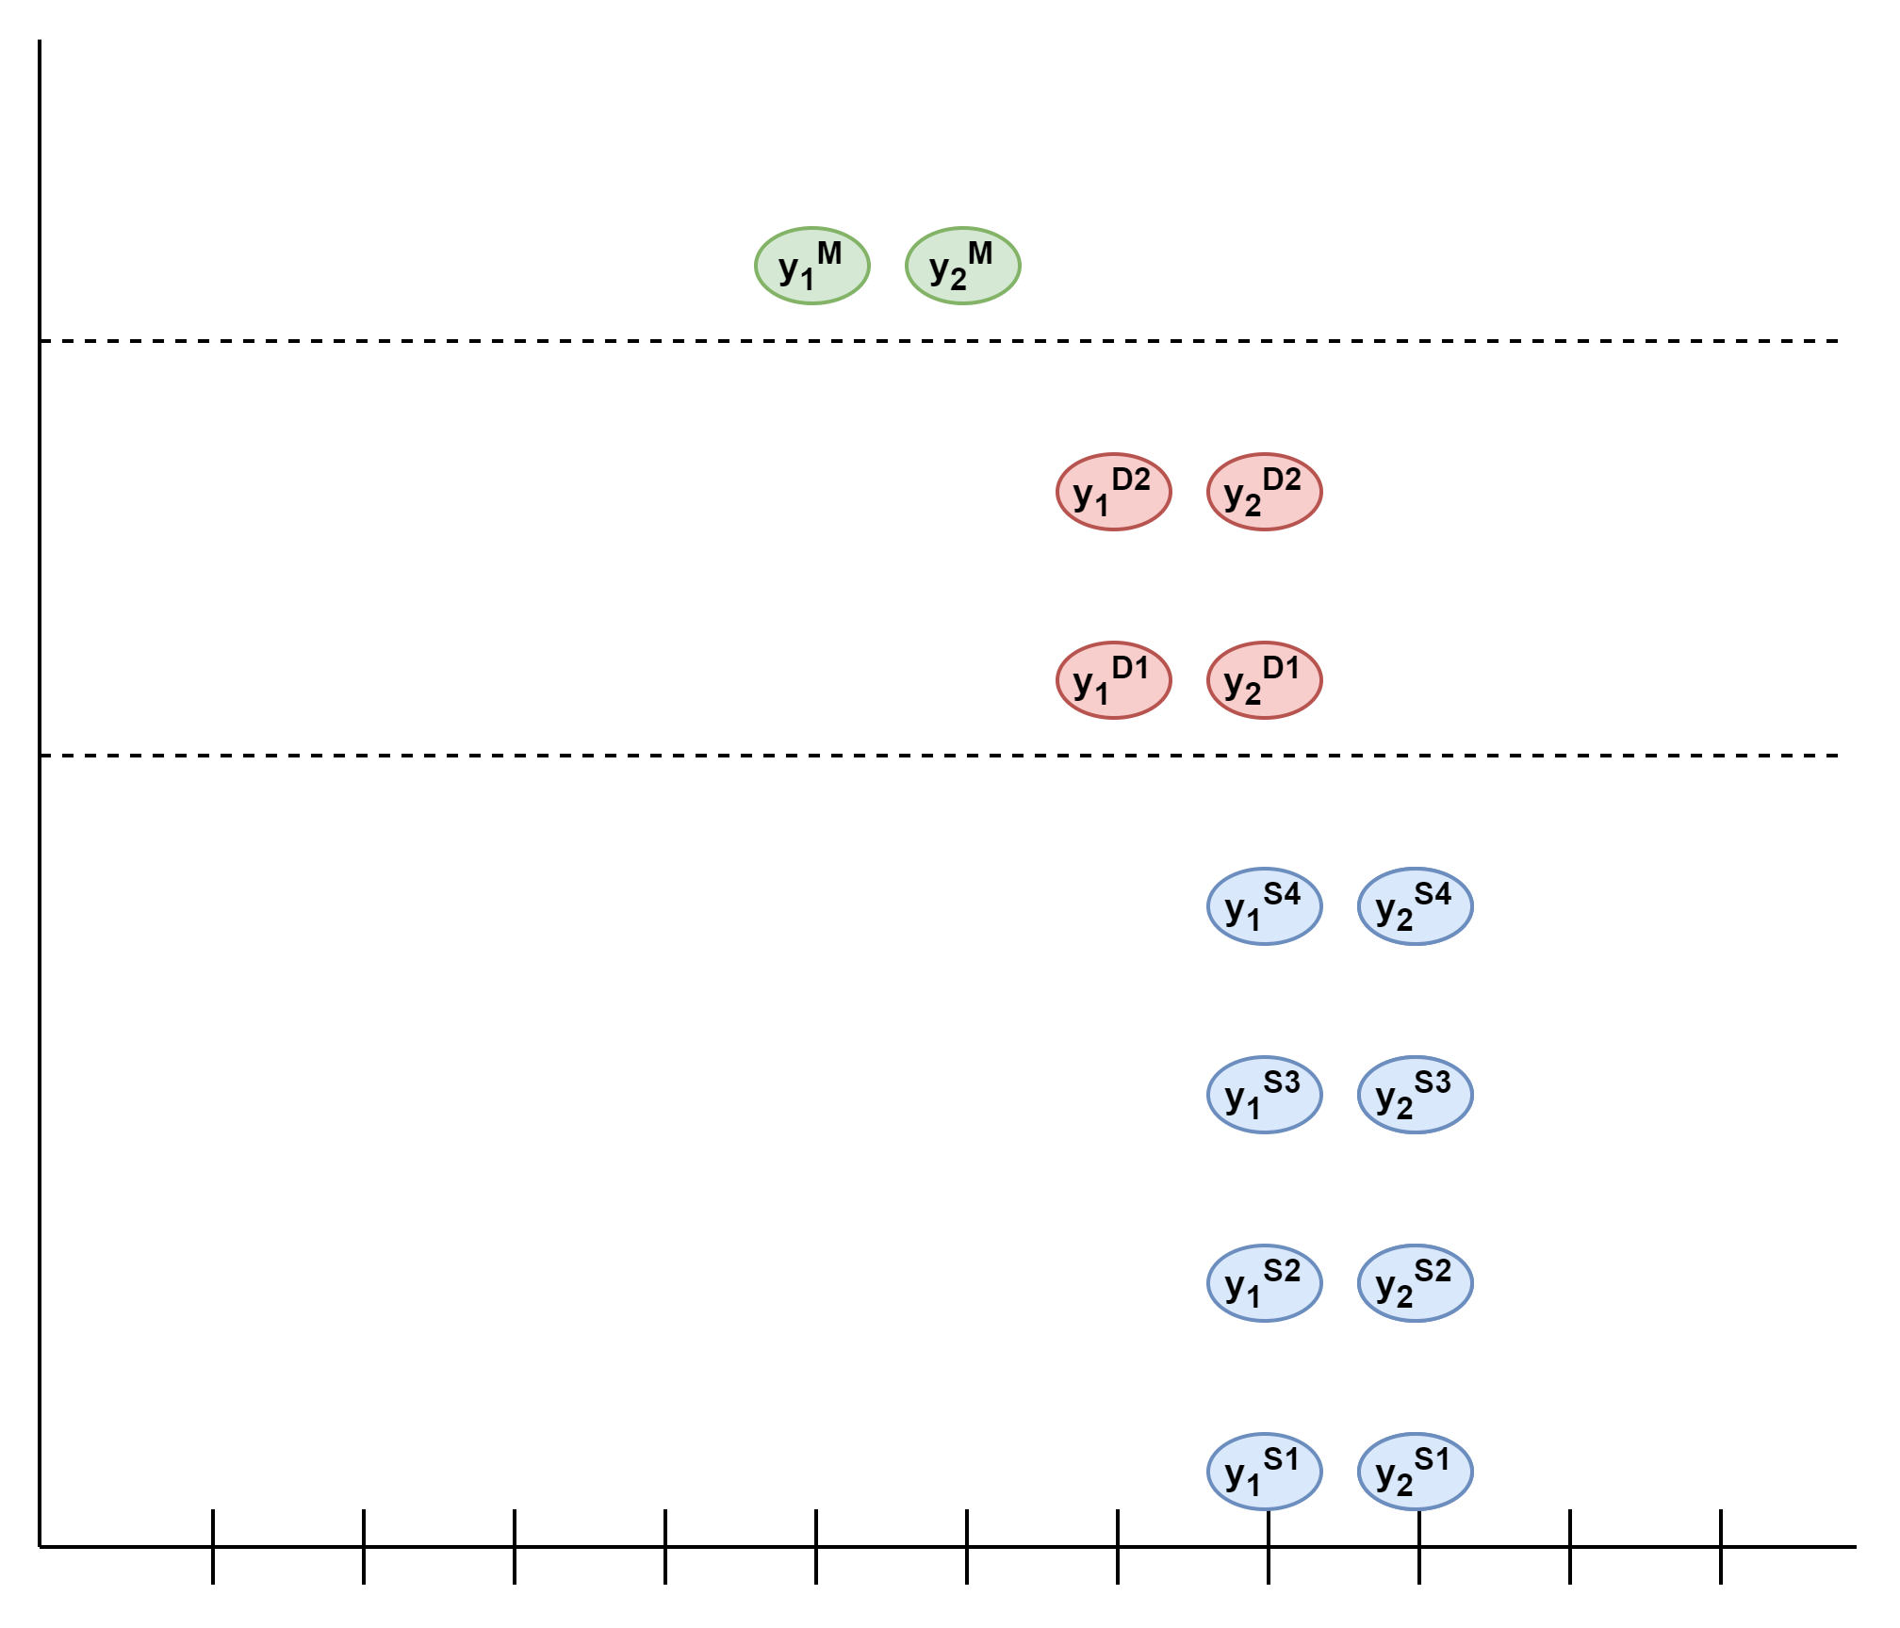
Another View of Supply Chains
Mapping a Supply Chain to a Hierarchy
Challenges
Stock at Hand
Recurrent Nature of Demand
Different Ordering Frequencies
When to Forecast?
Common forecasting times for different horizons
“Skewed” Hierarchy
Introduce the Time Dimension
t = 0

Slide 28
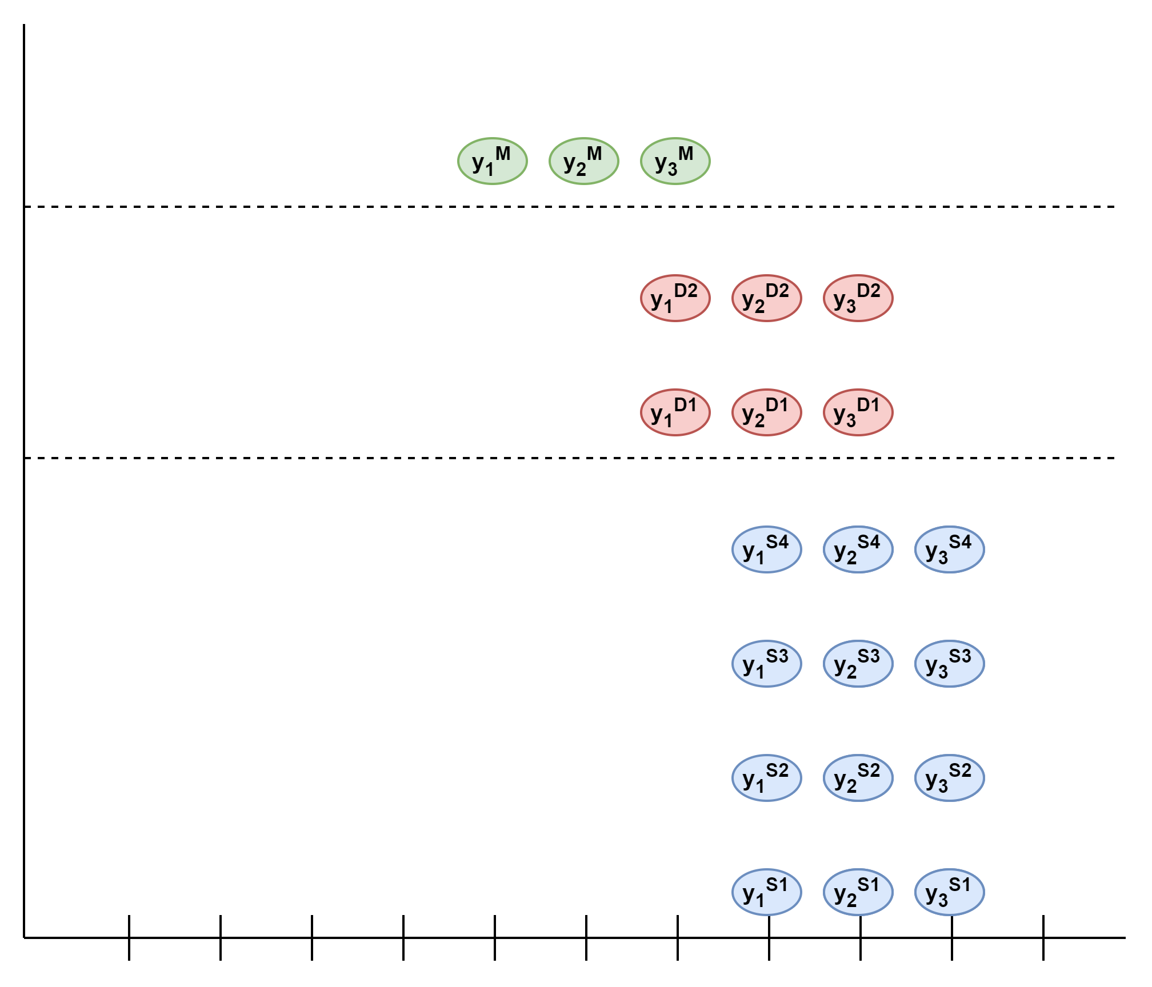
Another View of Supply Chains
Mapping a Supply Chain to a Hierarchy
Challenges
Stock at Hand
Recurrent Nature of Demand
Different Ordering Frequencies
When to Forecast?
Common forecasting times for different horizons
“Skewed” Hierarchy
Introduce the Time Dimension
t = 0

Slide 29
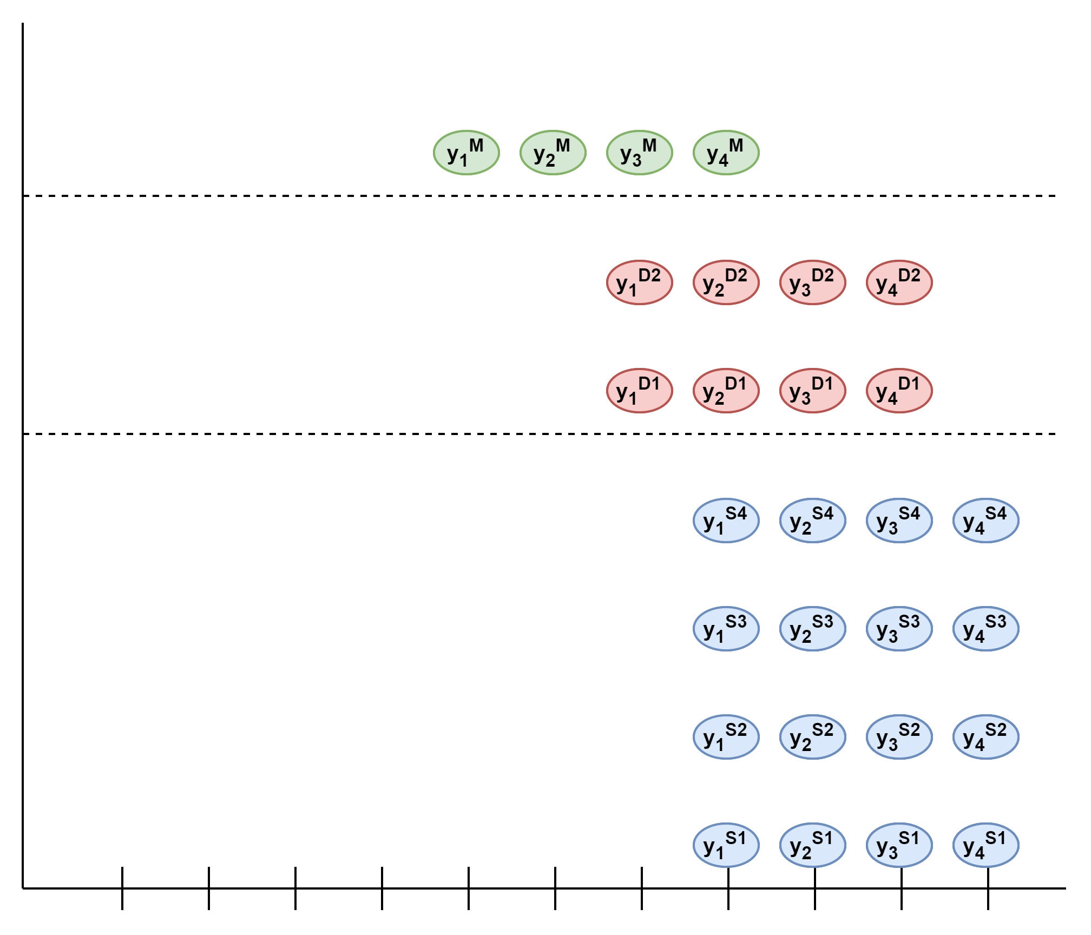
Another View of Supply Chains
Mapping a Supply Chain to a Hierarchy
Challenges
Stock at Hand
Recurrent Nature of Demand
Different Ordering Frequencies
When to Forecast?
Common forecasting times for different horizons
“Skewed” Hierarchy
Introduce the Time Dimension
t = 0

Slide 30
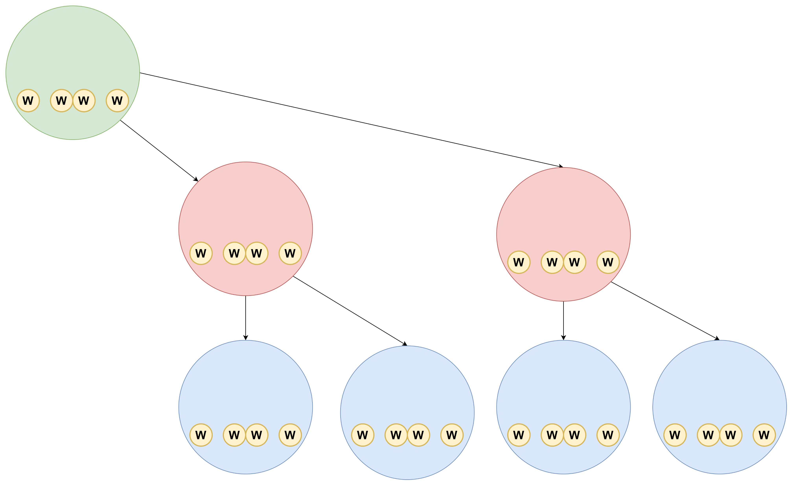
Another View of Supply Chains
Mapping a Supply Chain to a Hierarchy
Introduce the Time Dimension
Challenges
Stock at Hand
Recurrent Nature of Demand
Different Ordering Frequencies
When to Forecast?
Common forecasting times for different horizons
“Skewed” Hierarchy
t = 0

Slide 31
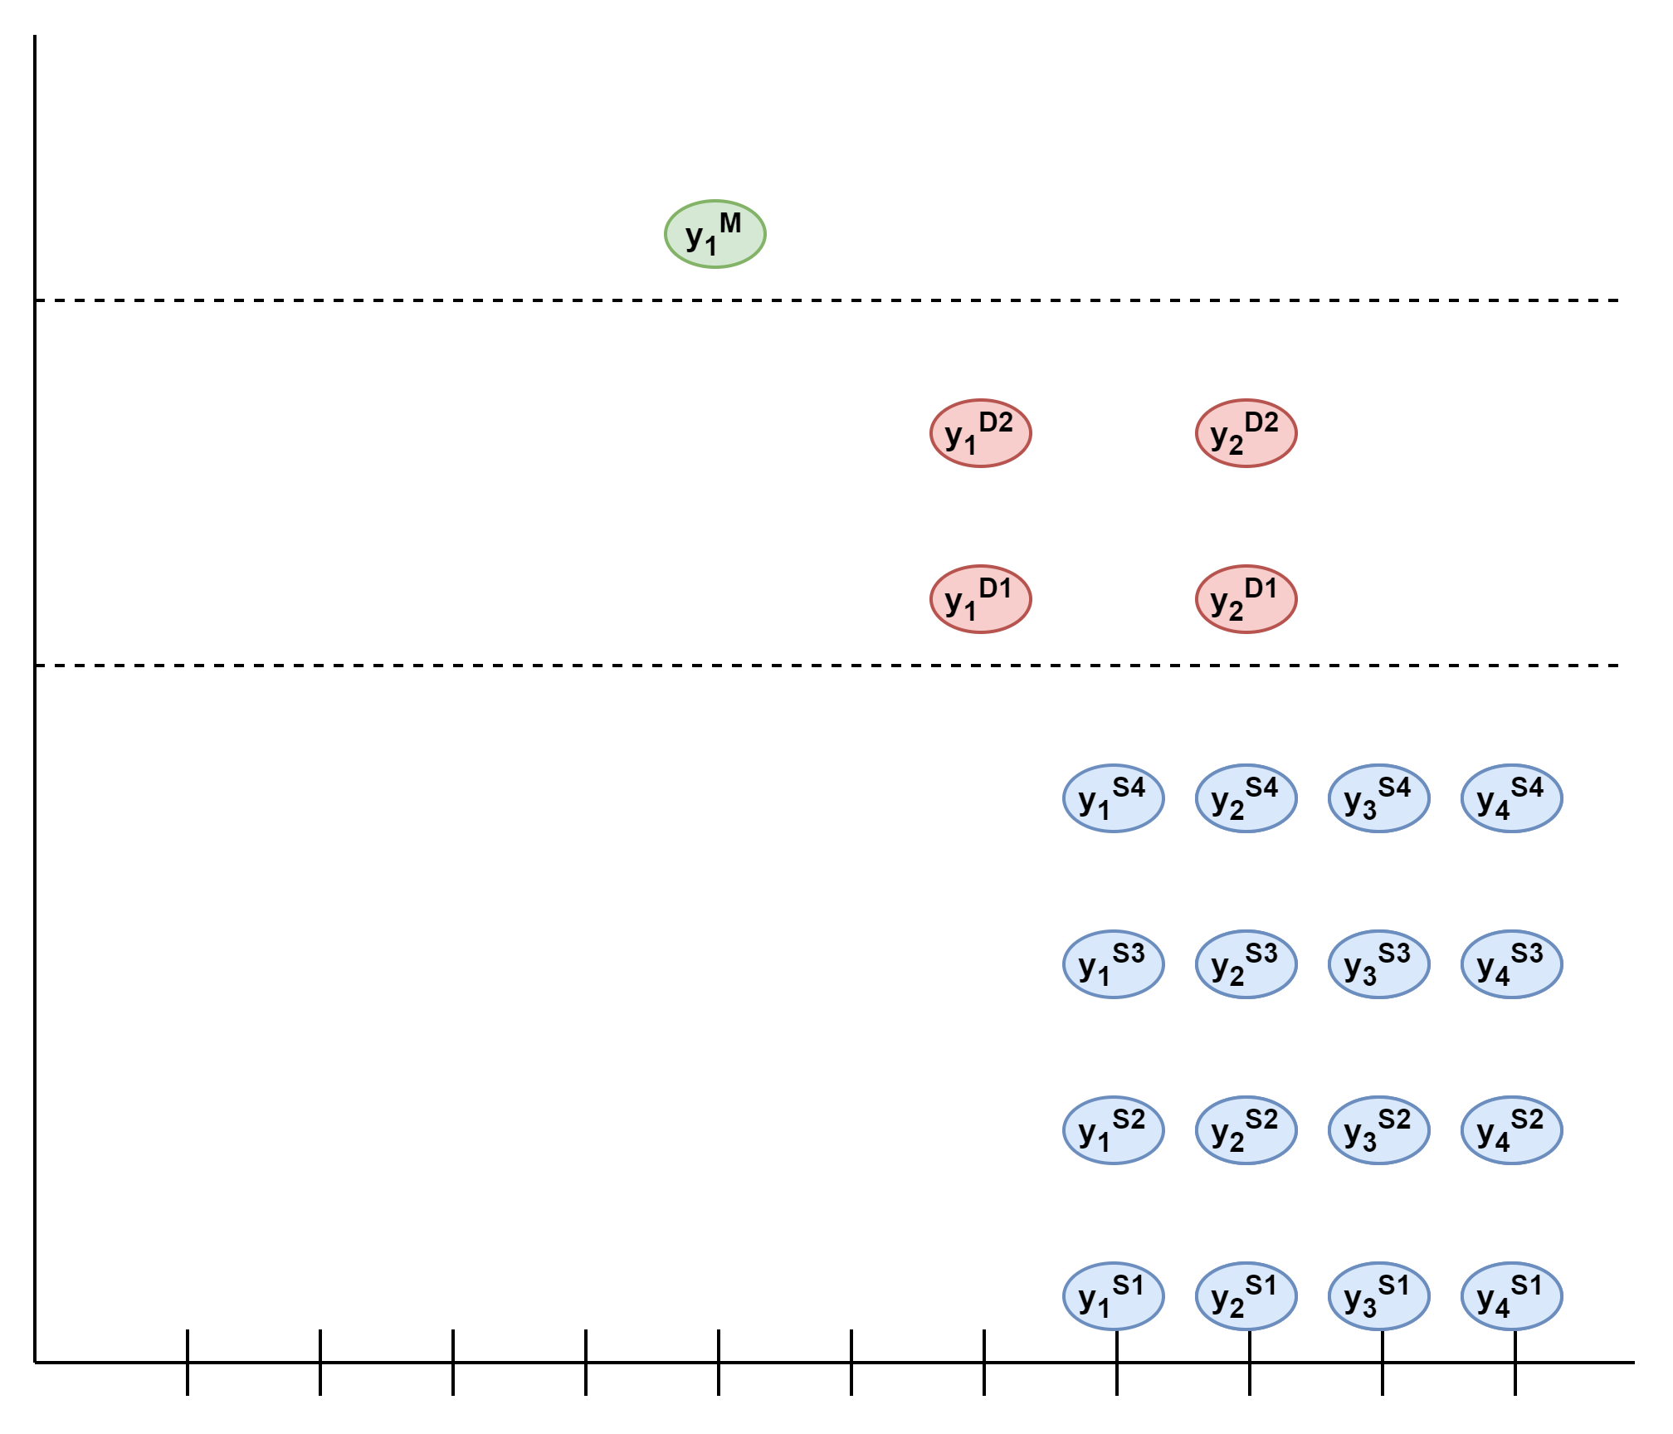
Another View of Supply Chains
Mapping a Supply Chain to a Hierarchy
Challenges
Stock at Hand
Recurrent Nature of Demand
Different Ordering Frequencies
When to Forecast?
Common forecasting times for different horizons
“Skewed” Hierarchy
Different Modelling Granularities
t = 0

Slide 32
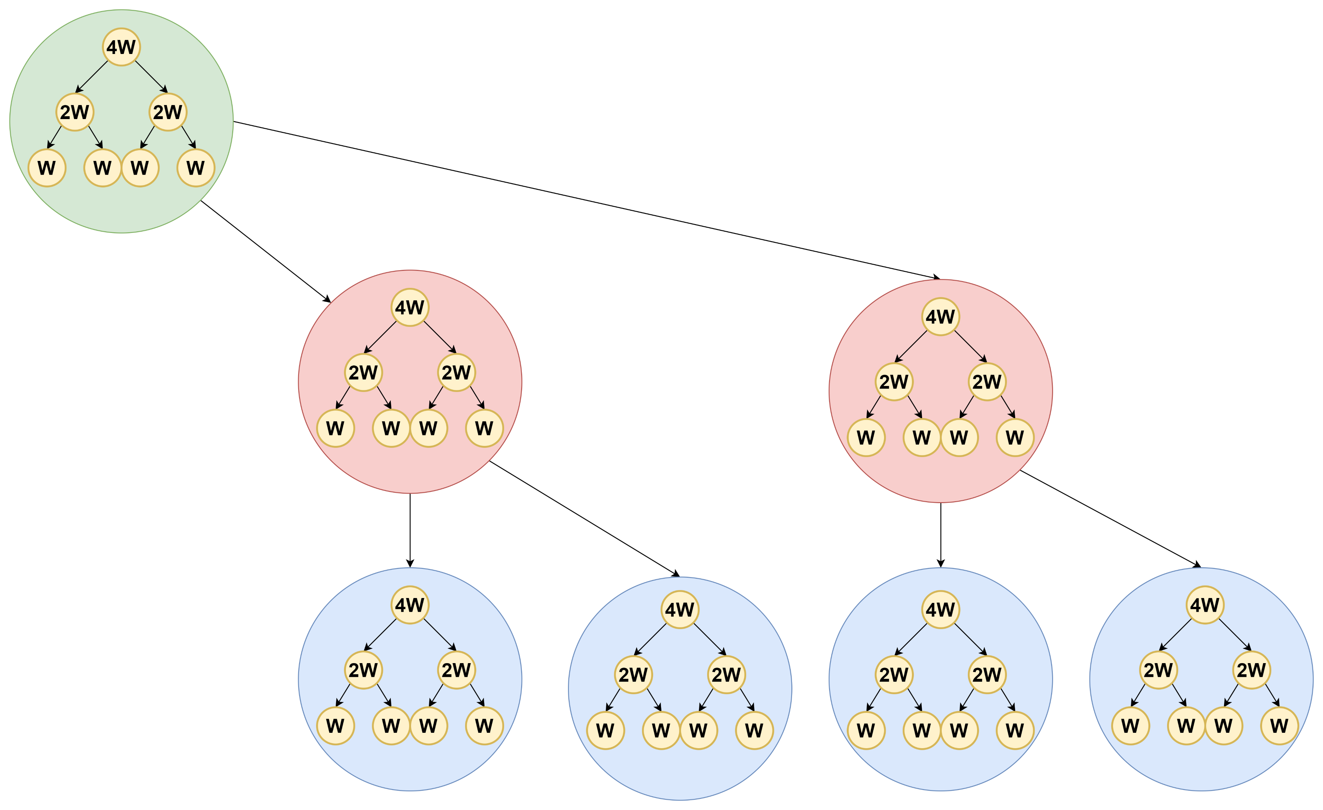
Another View of Supply Chains
Mapping a Supply Chain to a Hierarchy
Challenges
Stock at Hand
Recurrent Nature of Demand
Different Ordering Frequencies
When to Forecast?
Common forecasting times for different horizons
“Skewed” Hierarchy
Different Modelling Granularities
Idea 1:
Introduce all Temporal Levels
t = 0

Slide 33
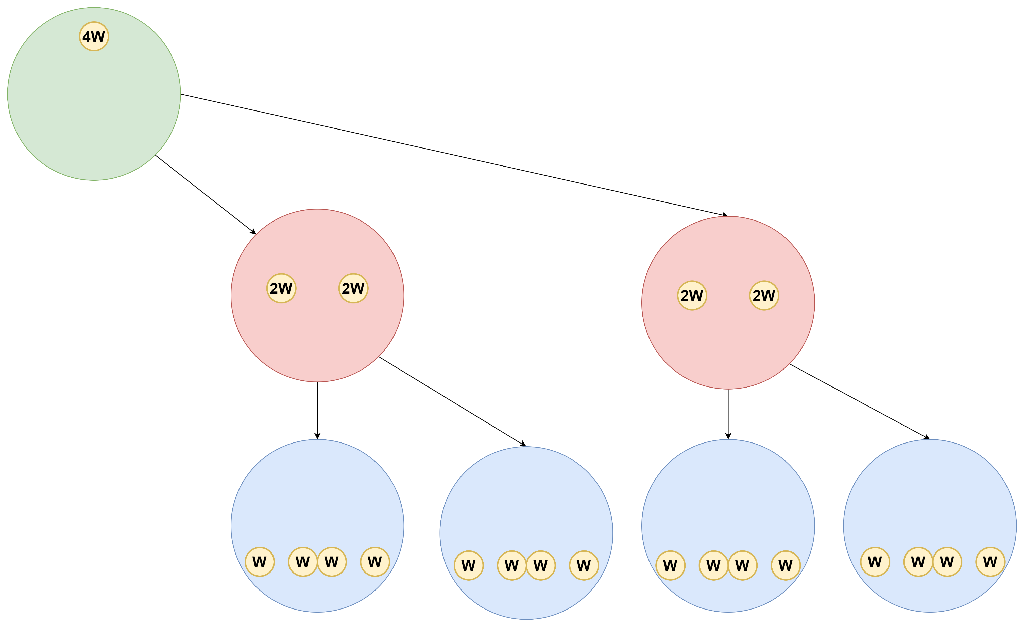
Another View of Supply Chains
Mapping a Supply Chain to a Hierarchy
Challenges
Stock at Hand
Recurrent Nature of Demand
Different Ordering Frequencies
When to Forecast?
Common forecasting times for different horizons
“Skewed” Hierarchy
Different Modelling Granularities
Idea 1:
Introduce all Temporal Levels
Idea 2:
Keep Relevant Levels Only
t = 0

Slide 34
Aim of this Work
Bridge the Gap
Optimize Inventories
Hierarchical Forecasting Literature
Supply Chain Collaboration
Challenges Summary
Consider, Demand, Stock-at-hand orders etc..
Higher level demand is low-level orderds
Different ordering periods, lead times
Skewed hierarchy with long forecast horizons
Reconcile Demand Forecast
Cross-Sectional Aggregations
Temporal – Hierarchies Aggregations
Coherent Hierarchy

Slide 35

The How to!
Proposed Methodology
Our Proposal:
Follow the Hierarchical Forecasting Methodology
Step 1: Base Forecasts for each Cross – Section
Forecast the Demand for Each Echelon
Global forecasting time
Different Frequencies
Step 2: Data – Driven Reconciliation: Solve Challenges
Neural Networks for Reconciliation (Theodosiou & Kourentzes, 2021)
Optimize on Selected Target Levels Considering Current Stock
Propagate Orders to Higher Levels
Theodosiou, Filotas & Kourentzes, Nikolas. (2021) Forecasting with Deep Temporal Hierarchies. SSRN Scholarly Paper ID 3918315. Social Science Research

Slide 36
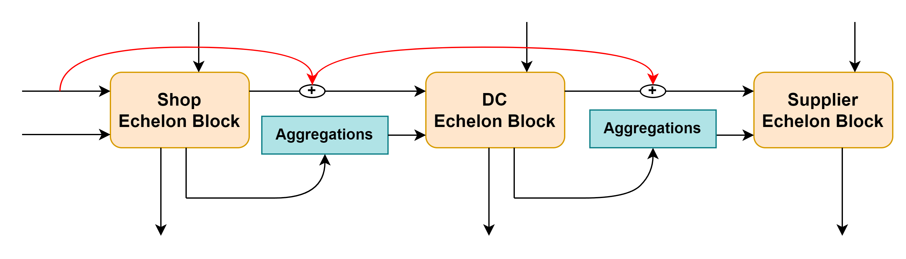













The How to!
Reconciliation Neural Network
Notations
Base Forecasts & Past Stock Values
Forecasted Demand for Each Echelon
Predicted Stock Target Level
Order Quantity
Current Stock
$${\hat{S_{0}}}^{S}$$
$${\hat{S_{0}}}^{D}$$
$${\hat{S_{0}}}^{M}$$
X
$$\hat{D_{t}}$$
Input X
$${\hat{D_{t}}}^{S}$$
$$\hat{S_{t}}$$
$${\hat{O_{t}}}^{S}$$
$${\hat{O_{t}}}^{D}$$
$$O_{t}$$
$${\hat{S_{t}}}^{S}$$
$${\hat{S_{t}}}^{D}$$
$${\hat{S_{t}}}^{M}$$
$$\hat{S_{0}}$$

Slide 37
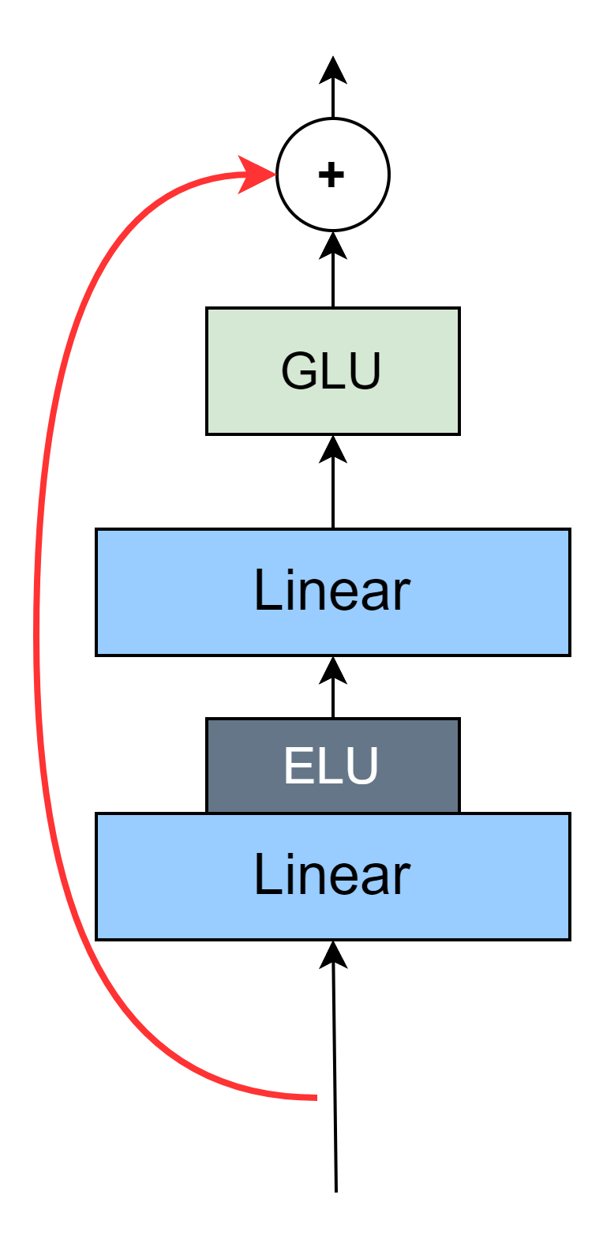
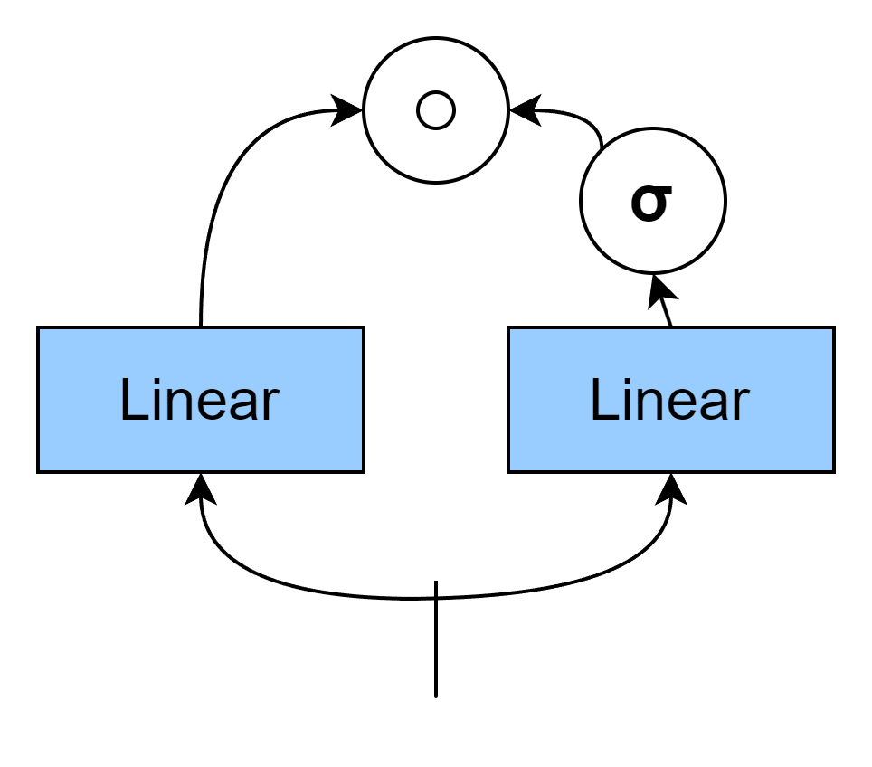
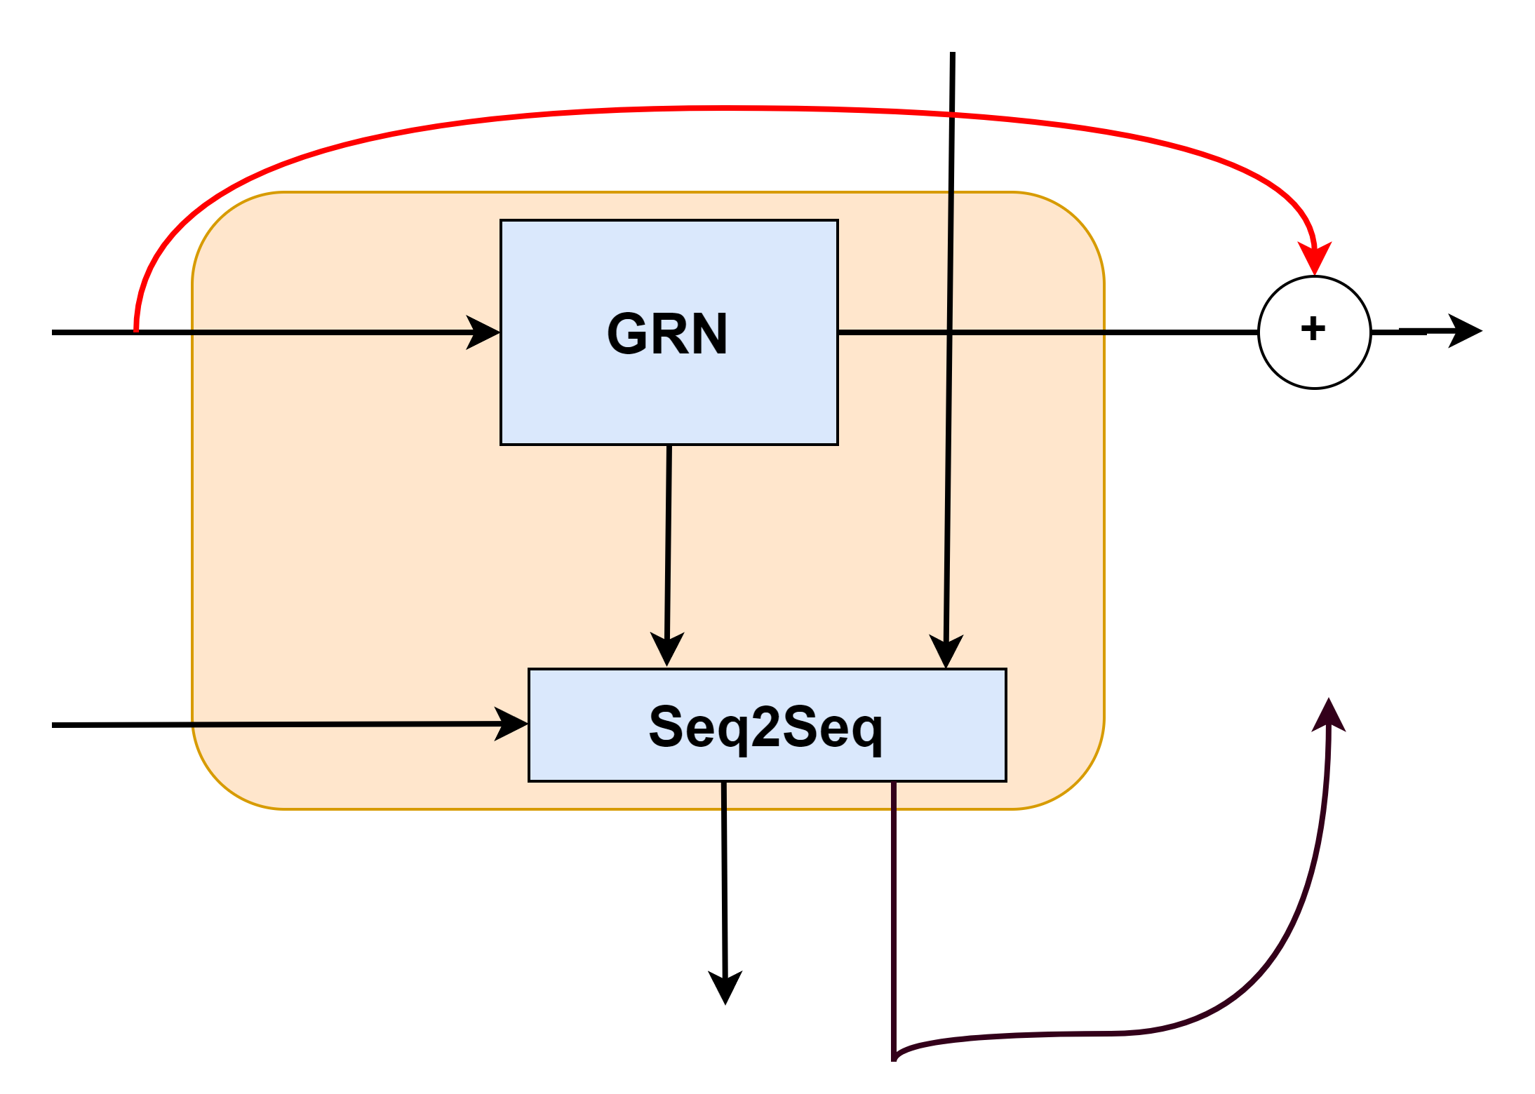
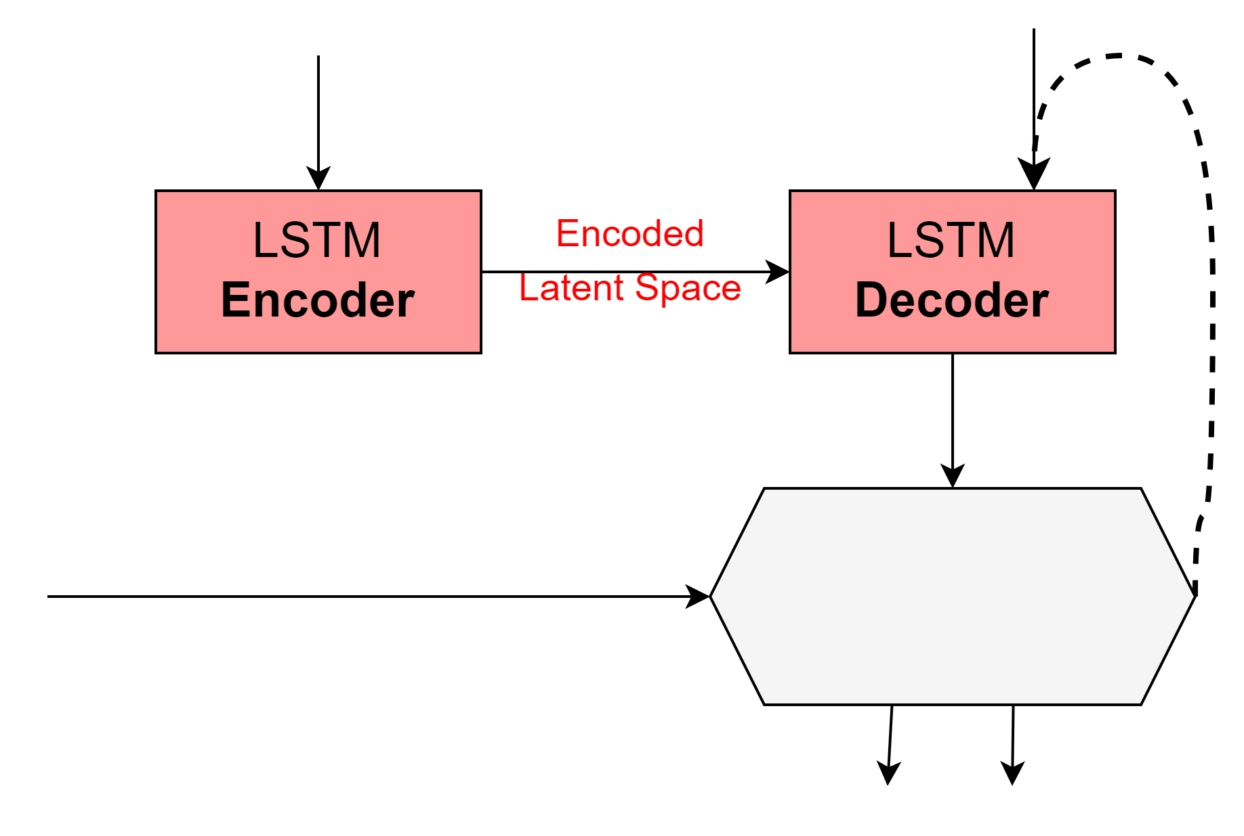












The How to!
Gated Residual Network (GRN)
Reconciliation Neural Network
X*
Gated Linear Unit (GLU)
Gated Residual Network (GRN)
Special MLP Architecture
Gated Unit (Softmax & Hadamart Product)
Filters Input Units
NNs struggle at Penalizing Features
Echelon Block
$$\hat{S_{0}}$$
X
X
Seq2Seq Model
Inspired from Machine Translation
Given Input and the Stock-at Hand:
Optimized on Stock Target Level
Outputs Order-Up Quantity
Given Demand, Updates Stock-at-Hand
Sequence to Sequence (Seq2Seq)
X*
$$\hat{D_{t}}$$
X*
$$\hat{S_{0}}$$
$$\hat{S_{t}}$$
$$O_{t}$$
New
$$\hat{S_{0}}$$
$$\hat{O_{t}}$$
$$\hat{D_{t}}$$
$$\hat{S_{t}} =\hat{O_{t}}+\hat{S_{0}}$$
$$\hat{S_{0}}=\hat{S_{t}}−\hat{D_{t}}$$
$$\hat{S_{t}}$$
$$\hat{O_{t}}$$

Slide 38
The How to!
Fitting the Model
Important Tips:
Independent of Base-Forecasting Model
Target any Service Level (Default is 95%)
Echelons Blocks can be optimized Separately Adjust for Newer Forecasts
Adjustable Loss – Function Penalize Overstocking, Stockouts based on costs

Slide 39
Experimental Design & Results
Empirical Experimental Design
Data: Multi – Echelon for 1 SKU
1 Manufacturer
4 DCs
274 Shops
Evaluation Period: 4 weeks (with time Shifts)
Lead Time = 1
For DCs: Bi-week 4-5
For Shops: Week 8-11
Target Service Level: 99%

Slide 40
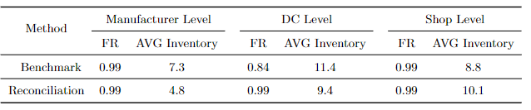
Experimental Design & Results
Experimental Results
Aim:
Reduce Inventory Size
Initial Results:
Intentory Size Reduction on High Levels
Limitations:
Long Forecast horizon on Shop Level
Short Term Adjustments do not Affect Higher Levels
Further Empirical Evaluations are needed!

Slide 41

Experimental Design & Results
Simulation Experiment
Understand the Effect of Inventory Decisions
Understand Behavior under specific Circumstances

Slide 42
Conclusion
Summary – Future Work
Our Aim:
Merge Inventory Optimization with Hierarchical Forecasting
Rely on Supply Chain Collaboration
Our Approach:
A Neural Network Architecture for Reconciliation
Address the problems in mapping a supply chain into a hierarchy
Assess the performance of the proposed model
Still work in Progress

Slide 43
Thank you for your attention ☺
Questions?
Filotas Theodosiou, Yves R. Sagaert
VIVES University of Applied Sciences
filotas.theodosiou@vives.be
www.linkedin.com/in/filotas-theodosiou/
Notes:
Abstract: Collaboration in the supply chain between a retailer and a supplier has been extensively researched. Much of the relevant literature has focused on the theoretical impact of this collaboration, with several studies arguing for its potential benefits, ranging from counteracting the bullwhip effect to reducing the likelihood of a stock-out. Despite this, most empirical work has focused on improving the accuracy of supplier-level forecasting. Using regression-based approaches, retailer sales information is included as exogenous variables to improve the supplier demand forecasts. However, this has limited benefits for the retailer. In this work, we aim to reduce total supply chain costs, both at the retailer and supplier level, by tracking decisions throughout the supply chain. These decisions are usually made on different frequencies. Our case study consists of a supply chain with three echelons: shop level, distribution centre (DC) and supplier level. The decisions about replenishing inventory are made at different times for each tier, causing the decision makers to model demand at different frequencies. Driven by the advances in the hierarchical forecasting literature, we propose ordering the demand time series into temporal and cross-sectional aggregations and structure them into a partial cross-temporal hierarchy. The decisions are not taken at the same moment across supply chain echelons but usually in a reactive manner that is prone to overstocking. The hierarchical approach allows to represent the propagation of decision-making, enhancing the potential for collaboration. This creates the potential for an AI-driven integrated supply chain. We examine how this hierarchical approach enables information sharing across decision levels and data frequencies and its impact on the total supply chain. We present the results based on data from a logistics network with 275 stores, 4 distribution centres and one supplier.

